Slide 1
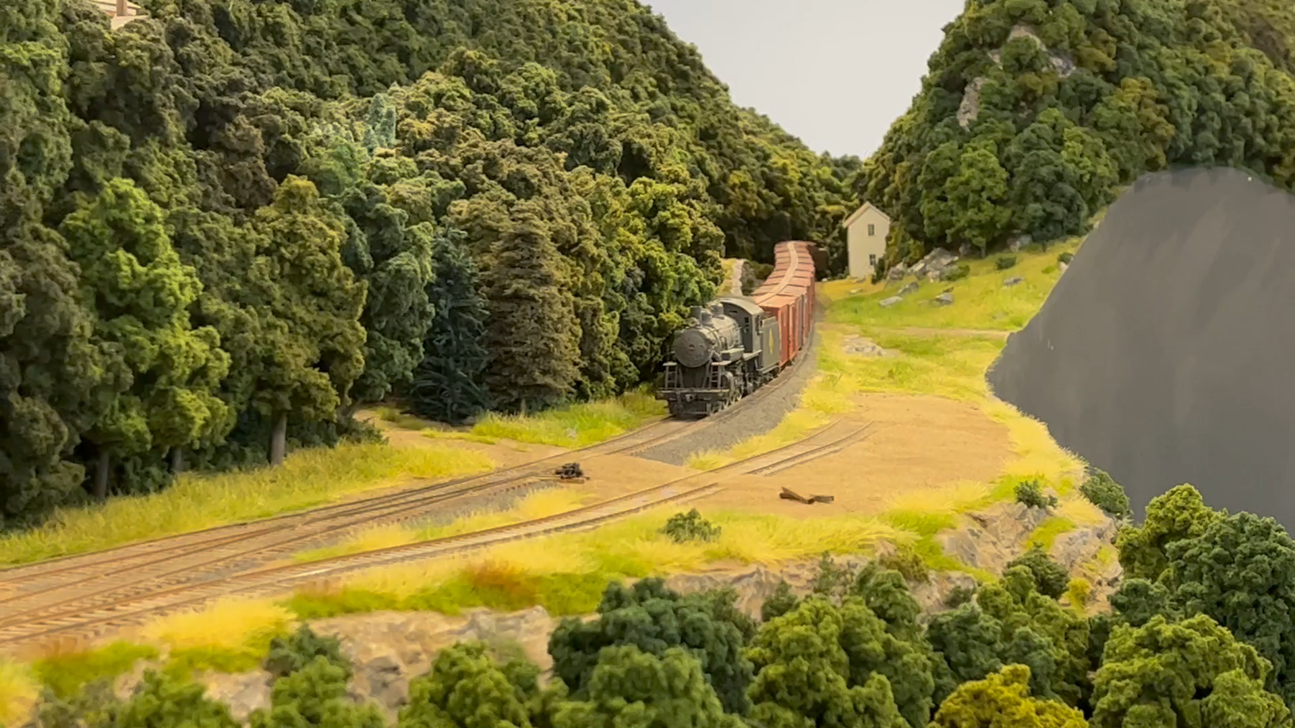
TECHNIQUES FOR BUILDING LARGE MODEL RAILROADS
By Willy Monaghan

Slide 2
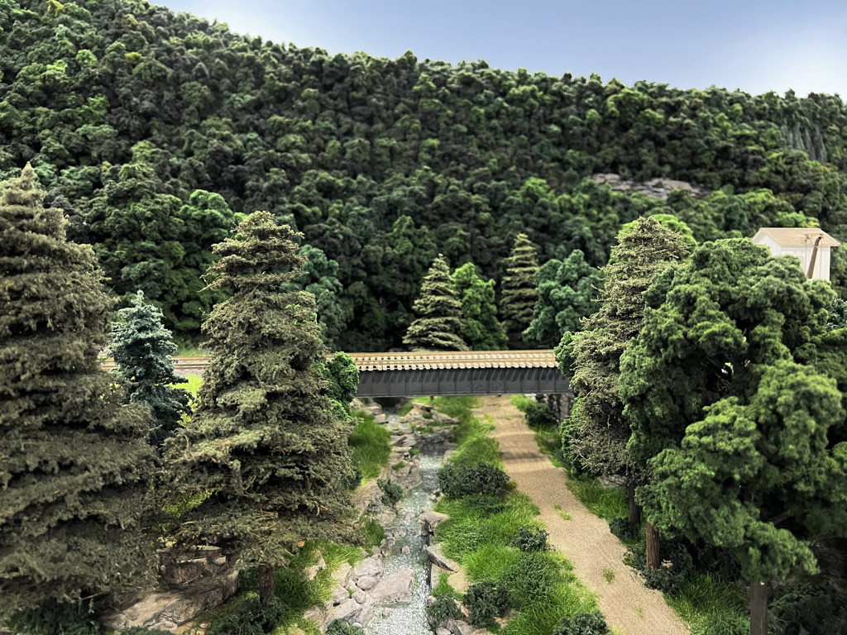
…OR WHY ARE THERE SO MANY UNFINISHED LAYOUTS?
Model railroad information is oriented toward scenes, dioramas, or 4 x 8 or shelf models. Large layouts cannot be completed with these techniques, because they work for square inches or feet, not square yards. From concept to construction, scalable methods of construction are essential.

Slide 3
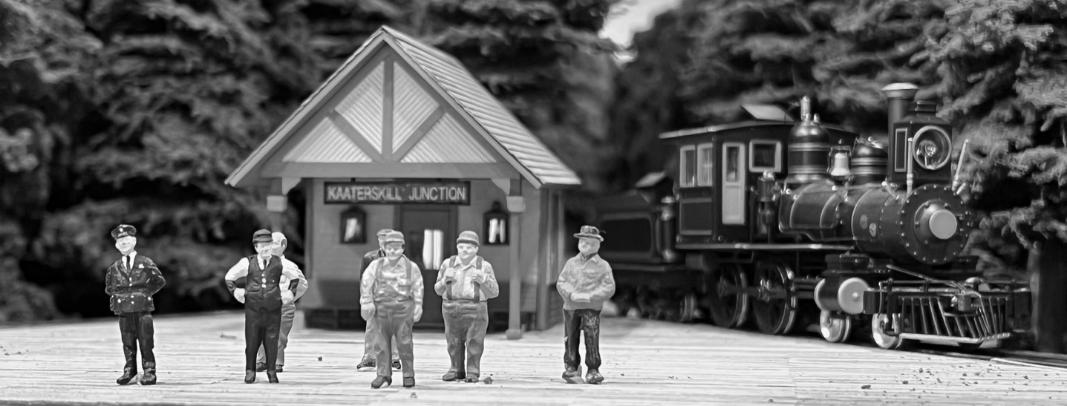
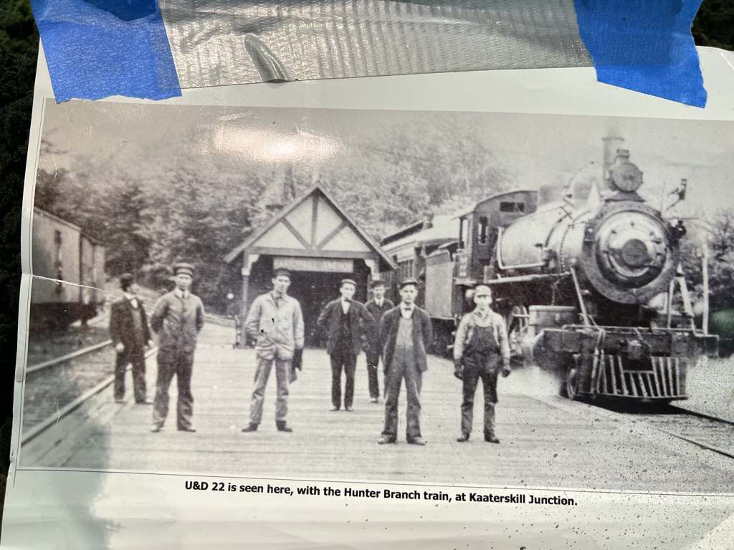
PLANNING FOR SCALE: PROTOTYPE
First, consider a real railroad. Maps and photos are readily available so you can move the design process ahead. The research is fun and it will be easier to find the details of your layout than it is to invent them. I have been an artist for 60 years and I cannot invent the complexity, irregularity, and beauty of the landscapes railroads traverse. And prototype modeling imposes a discipline that creates a believable, comprehensive suite of operations, track, rolling stock, and locomotives that I could not achieve with freelance.
It would be difficult to invent this tiny Eastlake station among towering Hemlocks at Kaaterskill Junction.

Slide 4
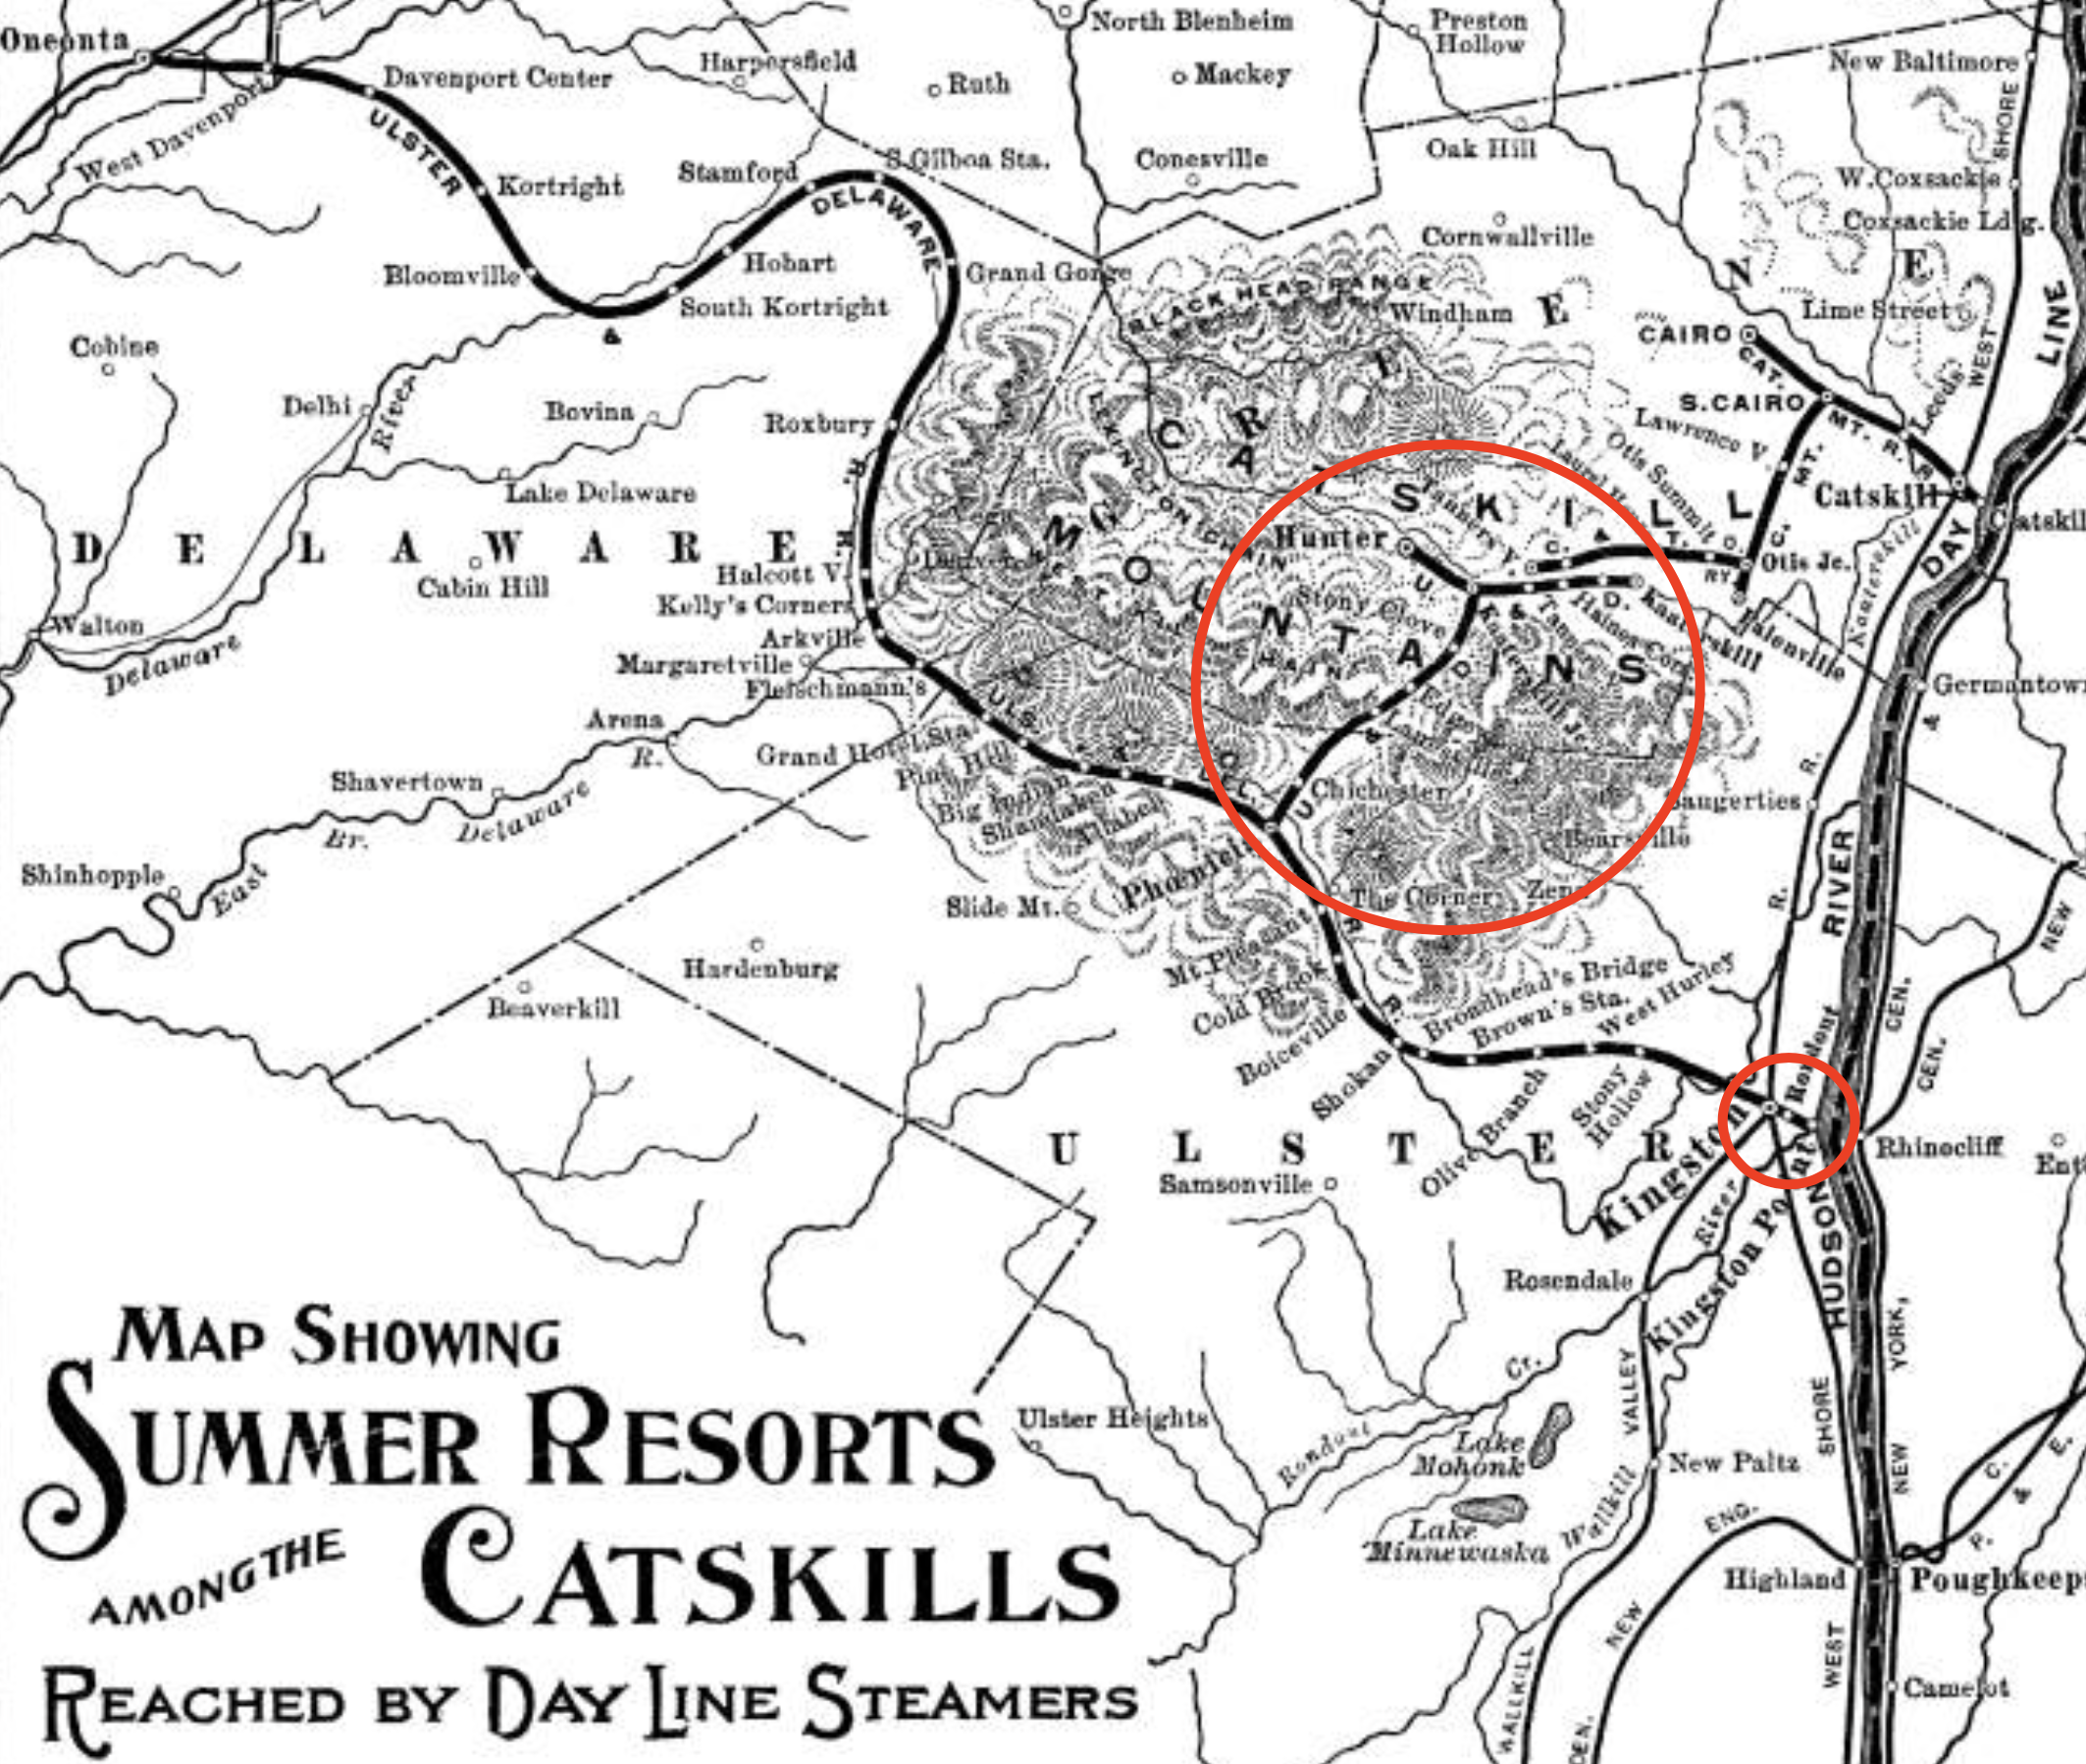
PLANNING FOR SCALE: MANAGEABLE SIZE
Survey your layout room and choose part of a railroad that will fit, so that you don’t have to reconfigure later because the caboose is in one station while the locomotive in the next. A buildable design means you have to resist the urge every model railroader has to fit in more than the space can handle. For instance, even though I have a 30’ x 65’ layout room, I chose only three stations and a branch line on a railroad that is only 100 miles long: the Ulster and Delaware Railroad, which runs west from the Hudson River to Oneonta with a branch to the Catskill plateau.
My layout models the routes circled in red, Rondout to Kingston and the branch.

Slide 5
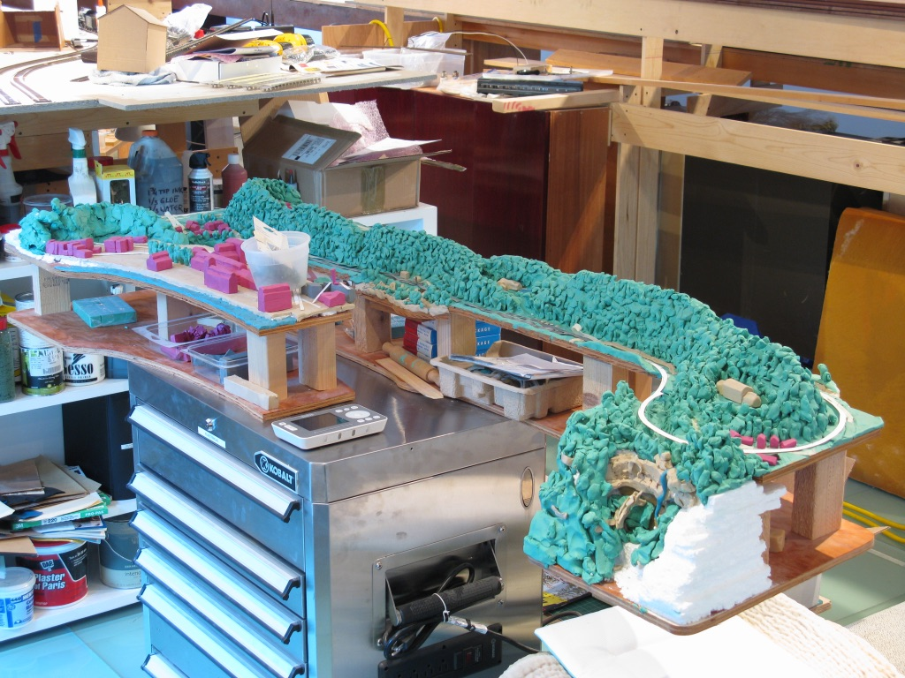
PLANNING FOR SCALE:
MAKE A MODEL
This one is 1/10.
A model is fast and accurate and saves months of drawing and disappointment when the layout doesn’t look like what you imagined.
Here you can develop specific strategies for your landscape, backdrop and view block, curve radii, spacing of towns, location of industry, passing sidings, switching leads, and the movement of the rail line through the scenery.
Plasticene clay buildings and landscape are easily shaped and modified in the design process

Slide 6
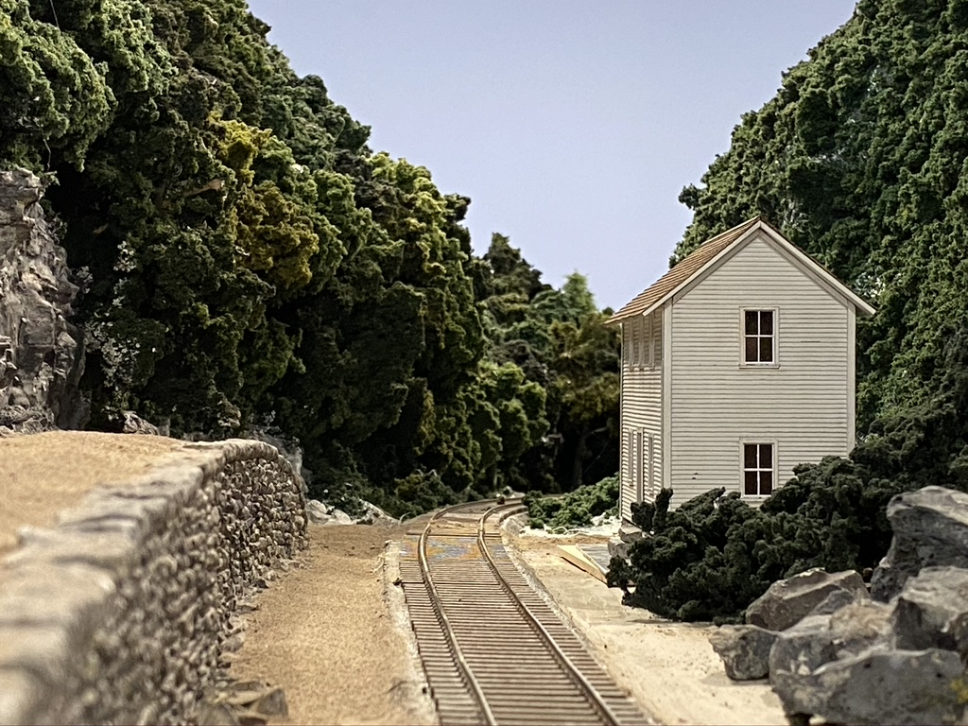
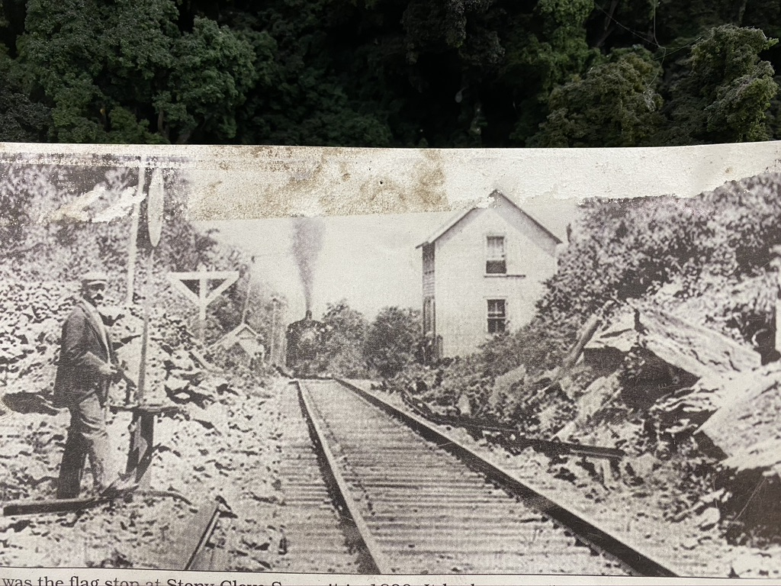
PLANNING FOR SCALE:
PLAN THE VIEWS
Viewblock with Landscape
Large layouts frequently present a sea of buildings, mountains, yards, and stations, leaving viewers overwhelmed. Several techniques can define scenes so the viewer can concentrate on what the builder wants them to look at. The route of the railroad running through the landscape can give definition to a view. During the planning stage for my railroad, I found three points where the railroad could run between two hills, through a valley, and disappear into the landscape. That gives me six routes that disappear into the landscape. Layouts at eye level are much more effective at controlling views.
Stoney Clove Notch summit with station

Slide 7
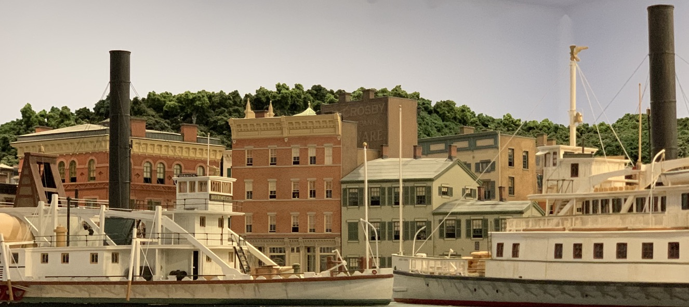
PLANNING FOR SCALE:
PLAN THE VIEWS
Viewblock with buildings
View of Rondout Harbor

Slide 8
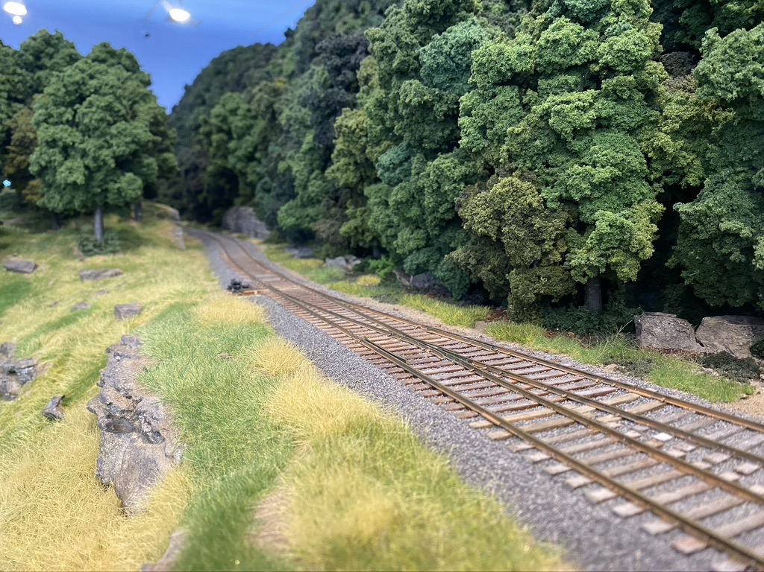
PLANNING FOR SCALE:
PLAN THE VIEWS
Viewblock an Edge-
Long stretches of track at the edge can draw the observer’s eye relentlessly around the layout, with no indication of where to look. The edge of the layout can be modified so that areas become part of a defined scene. I built a small hill extending to the edge fascia with a cut for the track topped with large trees. The viewer does not see downhill toward Phoenicia or uphill past Stony Clove Notch, so their attention is focused on the scene at Edgewood. The track has continuous curves and does not run parallel to the fascia.

Slide 9
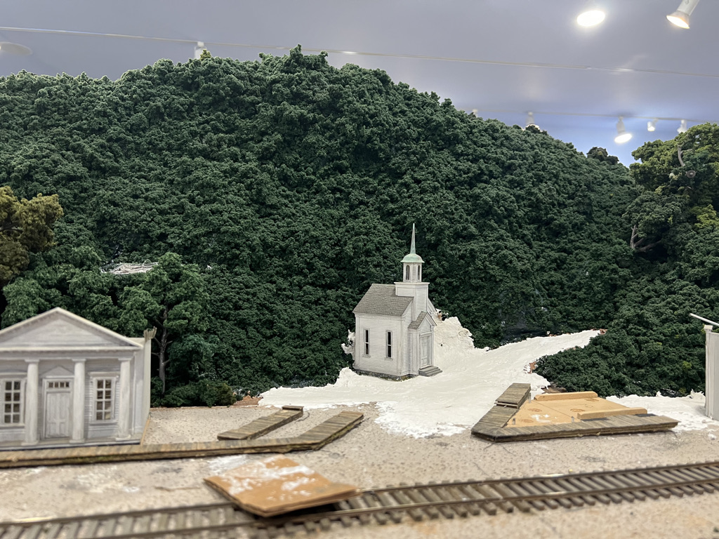
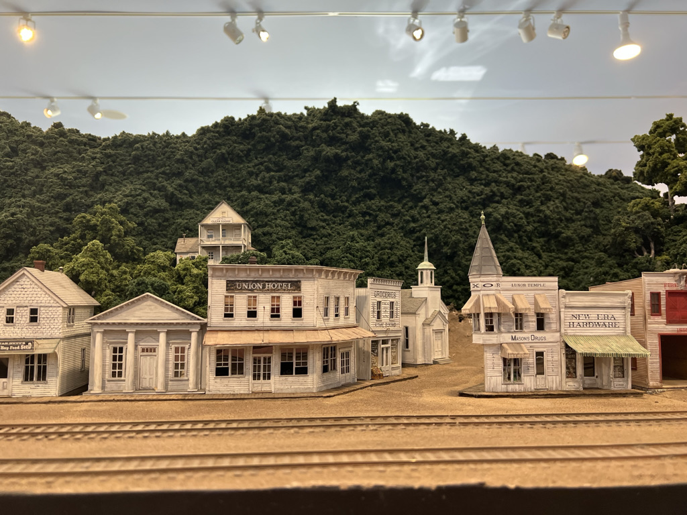
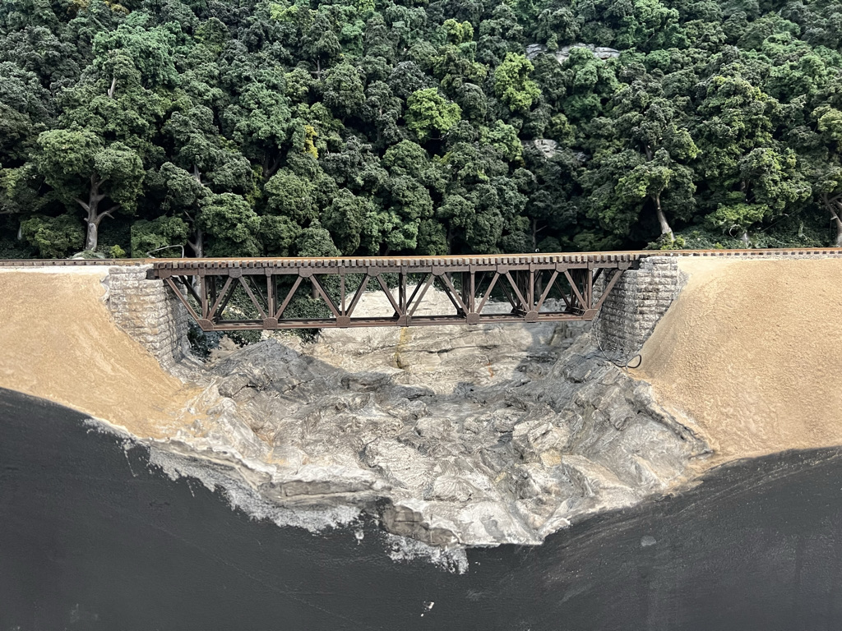
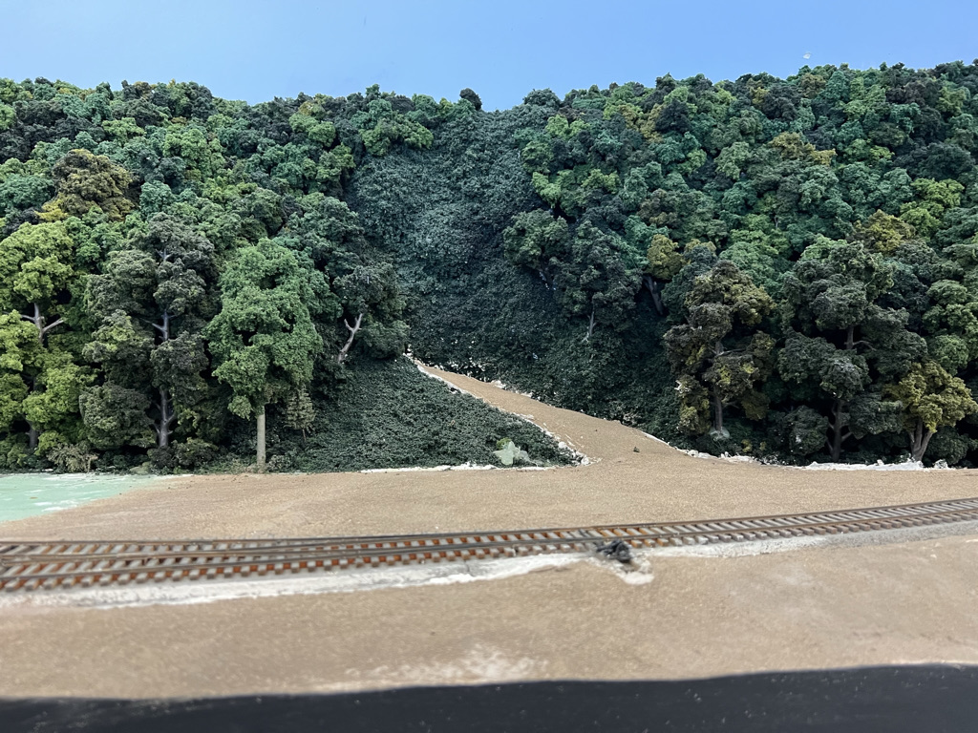
PLANNING FOR SCALE:
PLAN THE VIEWS
Illusions of Distance
Plan penetrations into the landscape by roads, streams, gullys, or valleys that turn past a view block to indicate greater depth and topographical variety and draw the eye into the scene.

Slide 10
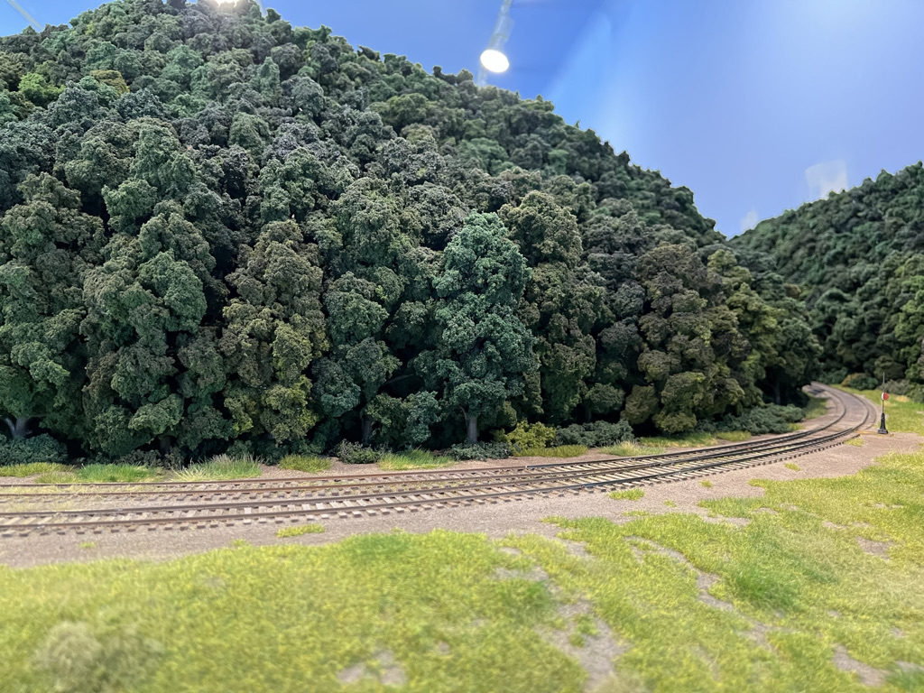
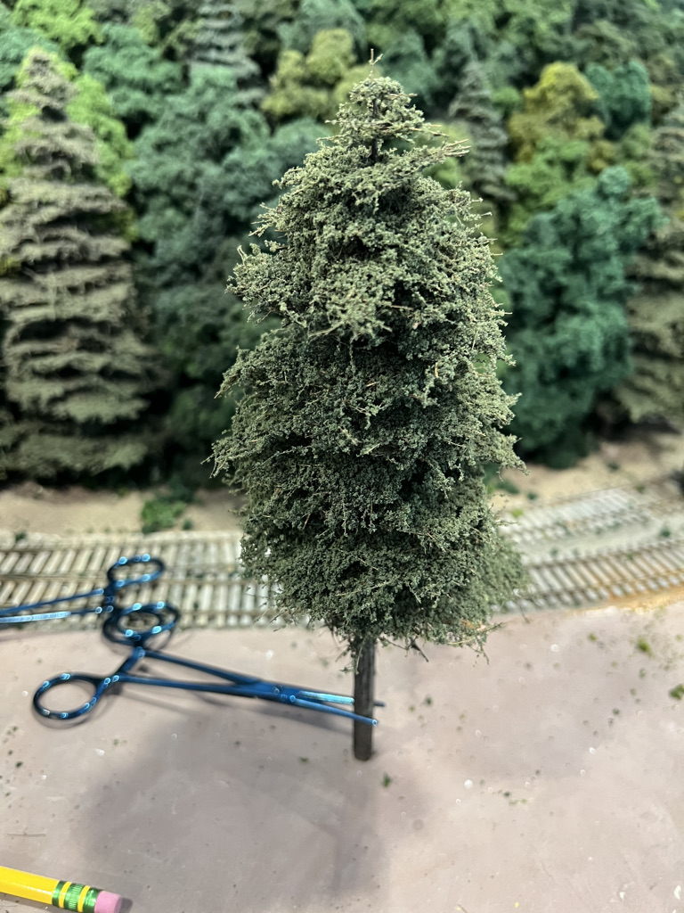
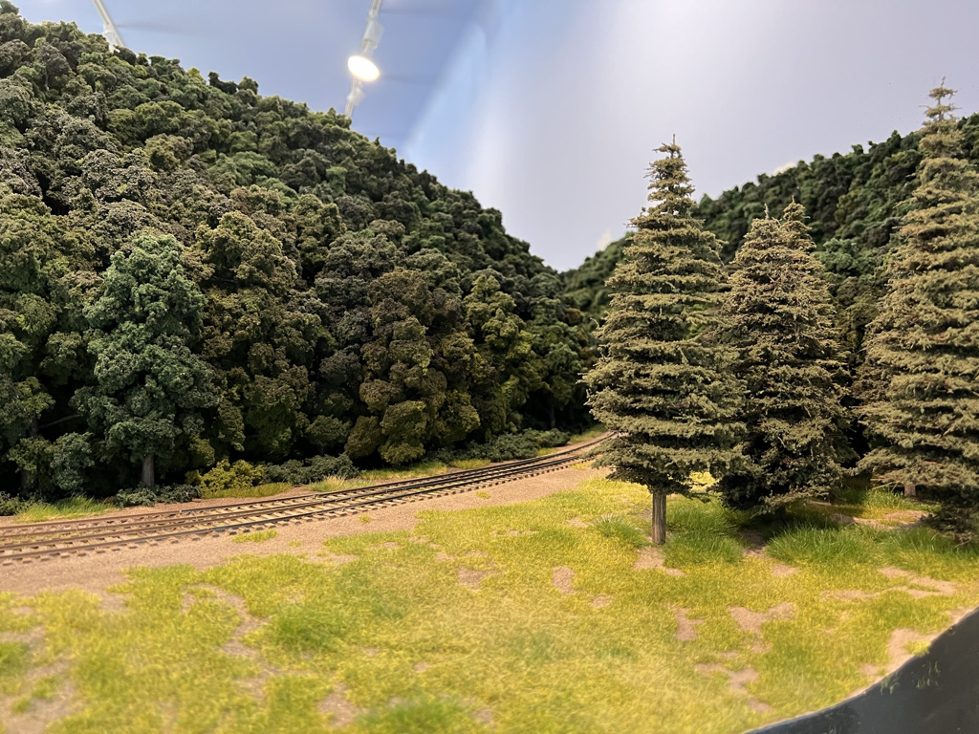
PLANNING FOR SCALE:
PLAN THE VIEWS
Mock Up the Scene
Evaluate your work and continually mock up the way the scene looks. For instance, the route to the right toward Hunter is much more interesting after I tried putting in some hemlocks in the foreground to partially obscure the view.

Slide 11
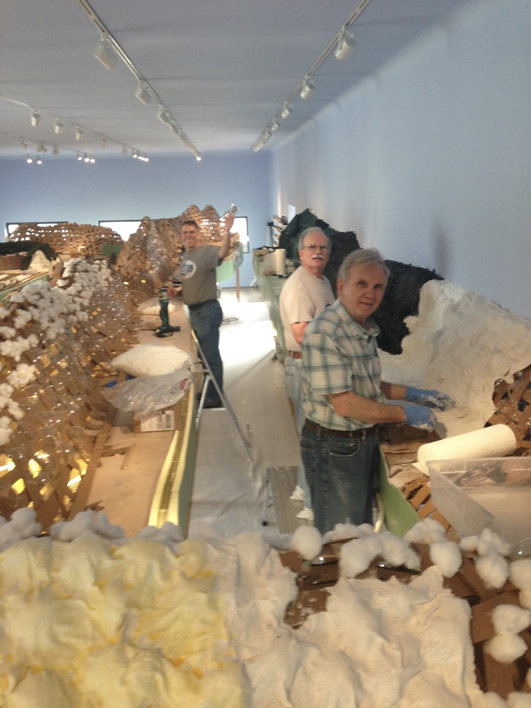
PLANNING FOR SCALE:
GET HELP
Here are the Crescent City S Scalers working on the Ulster and Delaware.
Articles, videos, and masters of diorama like Luke Towan offer extensive advice.
But these are generally about small pieces of territory. Luke Towan’s masterful creations take 15 hours per square foot. That’s 15 years working full time to build my layout. Large layouts require a discipline and specific technique that can work at a scale many times that of a diorama.

Slide 12
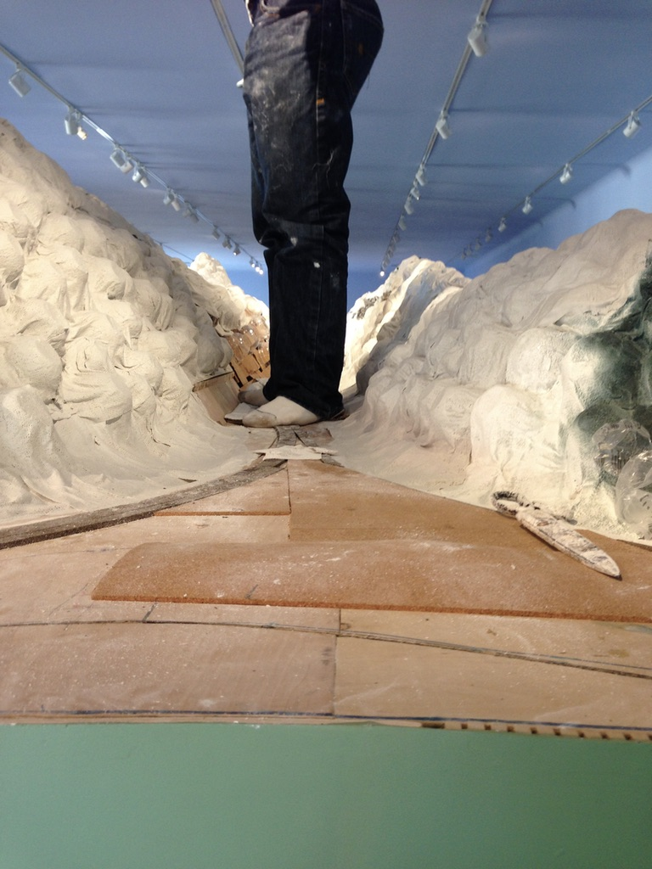
Scaleable Technique-Macro:
Plywood Subroadbed
Installs quickly in 8’ lengths and makes a solid, smooth subroadbed on L girder framing when joined with flitch plates glued and screwed to the underside. It is good as spline subroadbed with a fraction of the effort.
In the foreground is a large flat area that is solid 1/2” ply that will be Kaaterskill Junction. On the plywood you can see sheet cork used in larger areas like yards that matches the height of the cork roadbed. Do not use Homasote products as they are unstable with moisture, dimensionally inconsistent, and not flat enough on the surface.
Only use flat plywood!

Slide 13
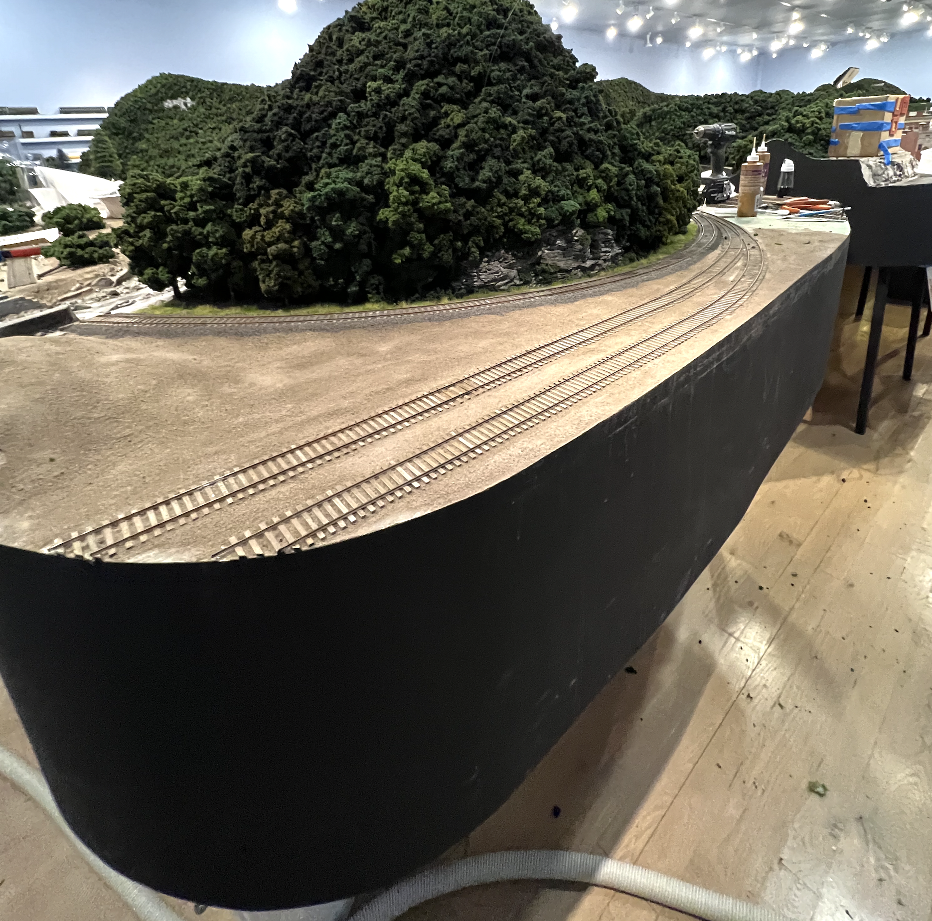
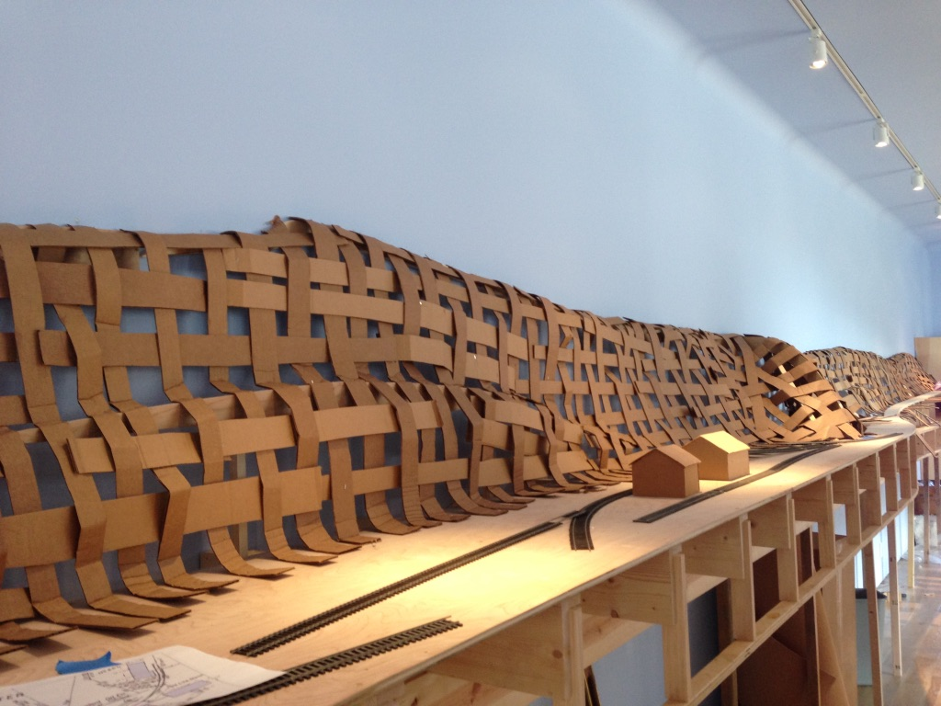
Scaleable Technique-Macro:
Integrate The Fascia
200 feet of fascia can’t be added later or it will wreck the edge of your landscape. Do not use plywood paneling because it is made to install flat on walls. It will not bend or join effectively. Frame 3/4” profile boards into the L girder system. Graceful curves can be formed with products like “wiggleboard” and ”bendy mdf” glued together with a plywood flitch plate behind, and joined with sheetrock tape to make a continuous fascia. I like to have the landscape run over the top of the fascia making a clean edge instead of showing the top of the fascia. Use ca to bond any cracks where the landscape hits the fascia.

Slide 14
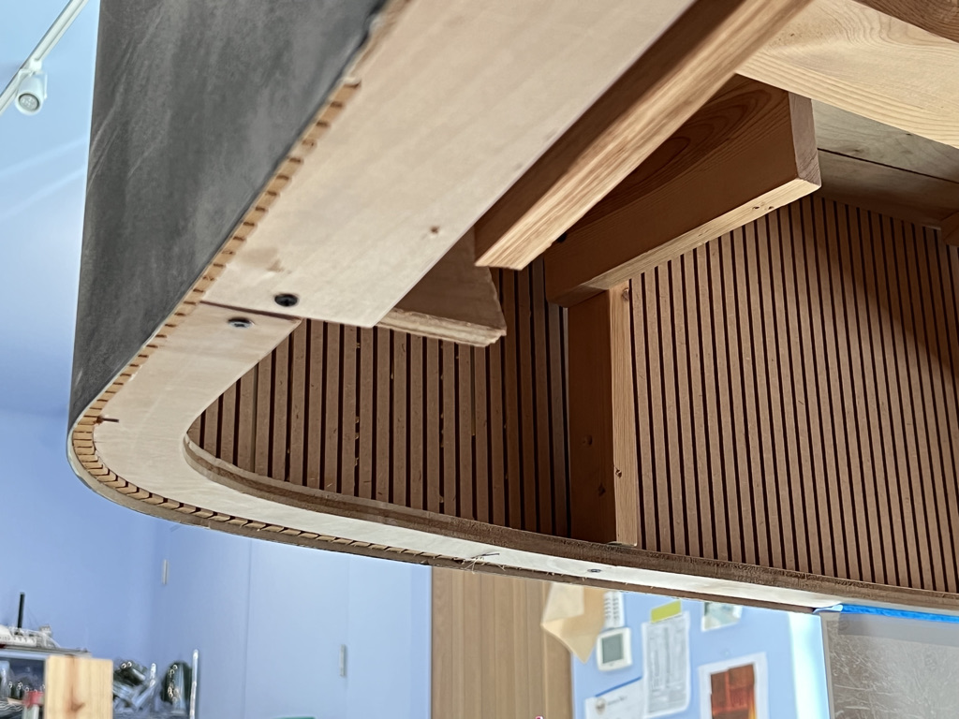
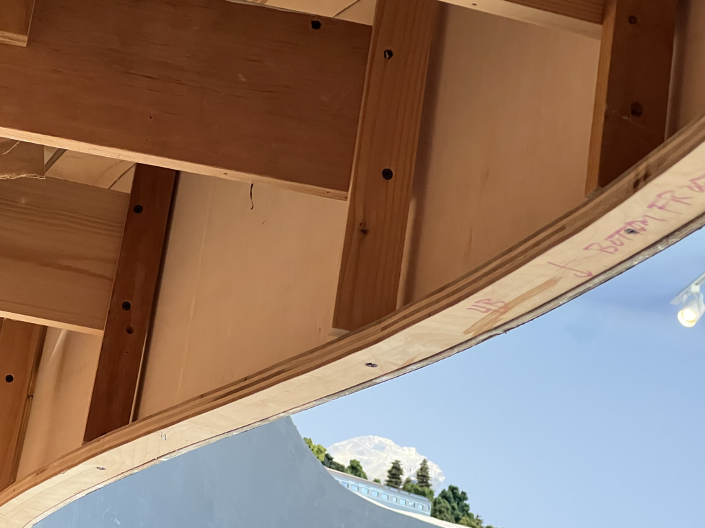
For gentle curves use “wiggle board” or another of this
type of 1/4” ply for bending. They have all the plys running
in the 4’ dimension so the entire sheet will bend.
For tight radii use “bendy mdf” with 3/4” profile
boards at top and bottom to form curves.

Slide 15
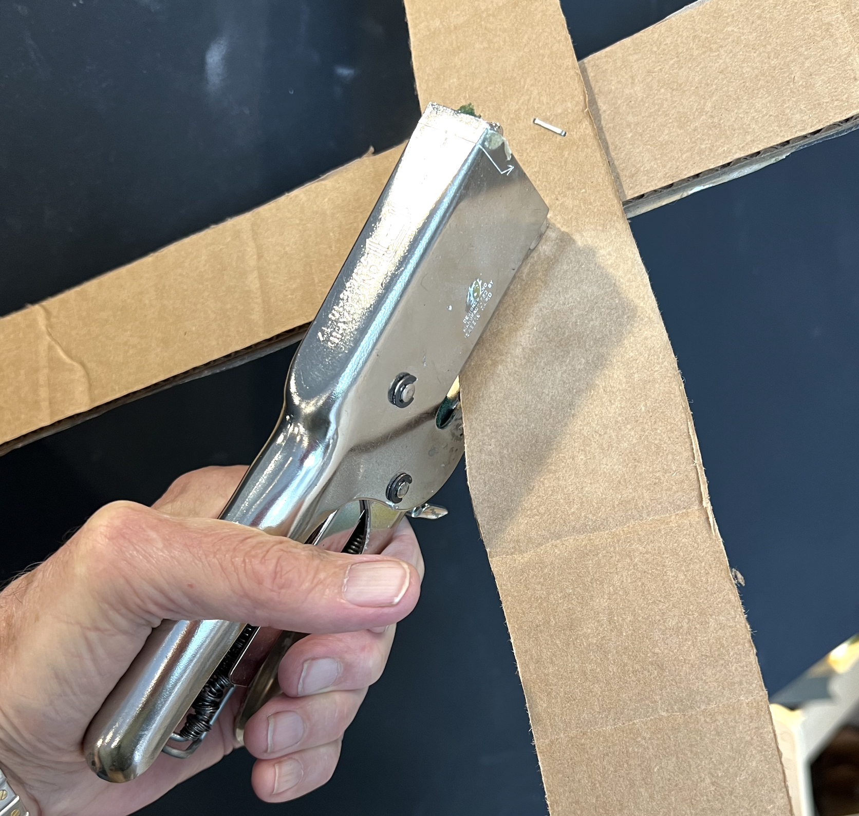
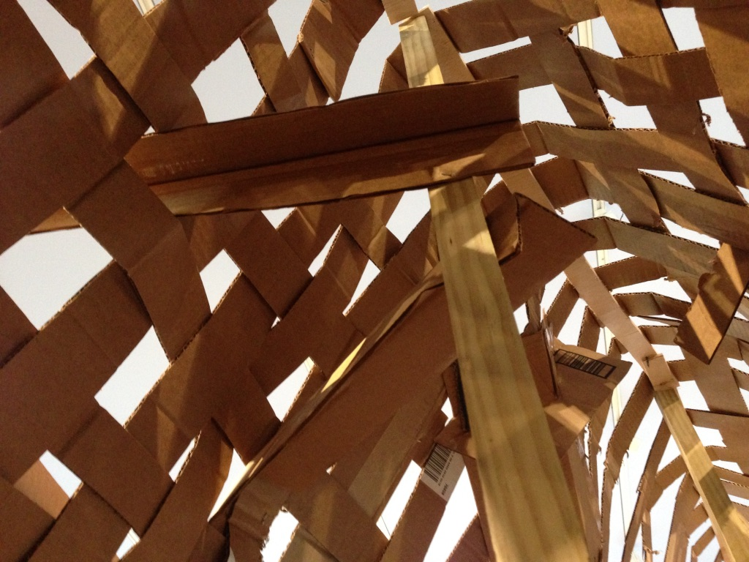
Scaleable Technique-Macro:
CORRUGATED MESH
Find mattress boxes or buy 4’ x 8’ sheets and cut strips 8’ long for efficient installation and to avoid splicing. Smaller boxes will take too long. Only a few supports are needed.
Staple strips to the edge of the subroadbed and supports. Use an anvil stapler to staple strips together. I use a Rapid Heavy Duty 31 shown at left.
Rapid Heavy Duty 31
anvil stapler

Slide 16
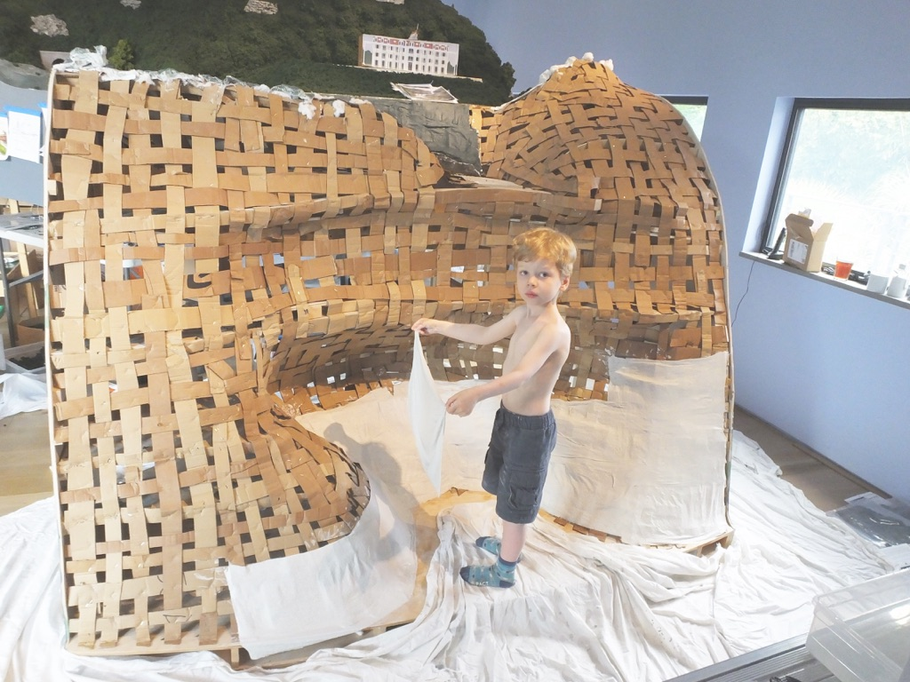
Scaleable Technique-Macro:
Terrain
Large model terrain requires efficient 3D construction. I found woven corrugated and plaster cloth to be the fastest, lightest, and easiest to modify. Two layers of plaster cloth is strong, it’s available by the case, and it takes a fraction of the time required by other methods like paper towels.

Slide 17
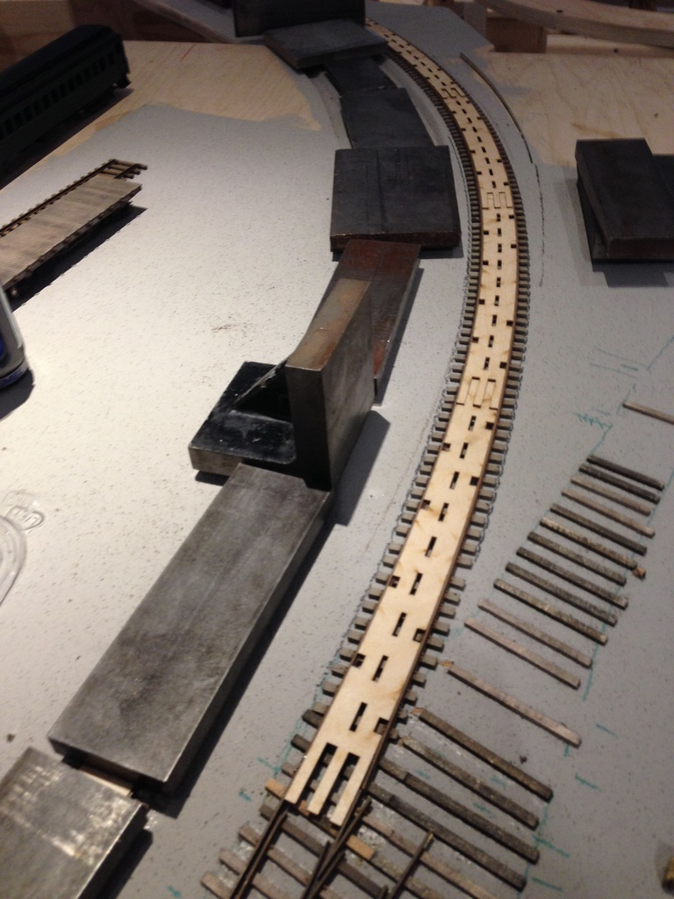
Scaleable Technique-Macro:
Track
Hundreds of feet of track calls for flextrack. Use track templates for smooth curves and reliable operation. Remove a few ties at junctions of track and put down wood ties to spike rail in place to reduce kinks at the intersections. Glue track down with white glue and weight it to hold it flat. If you want to make a change, just wet it for a while and it will come off. Pre-made switches save months of work (I like Tomalco). A head start is needed because I spend additional time on many switches modifying them to fit the track plan and making more realistic bridles and throw bars.

Slide 18
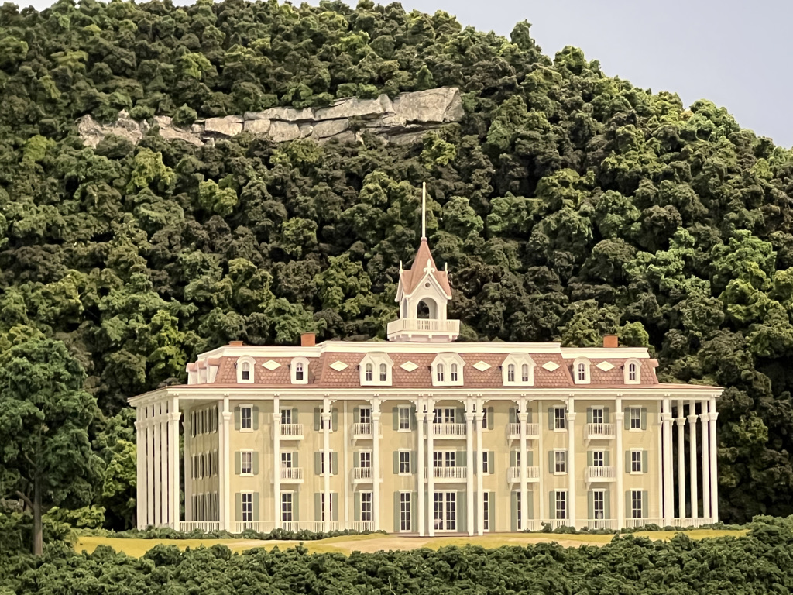
SCALEABLE MICRO:
BACKGROUND TREES
The most efficient way to produce background trees for hills is to form 1” to 5” balls of black polyfill fiber, spray them with 3M adhesive, and cover them with Woodland Scenics clump foliage. Make them lumpy of they will look like tennis balls. Then, or after installing over dark green paint, spray them with diluted black ink to produce a variety of colors. First edge of woods trees with trunks, then large balls behind them graded to small ¾” round at the top creates an illusion of distance.

Slide 19
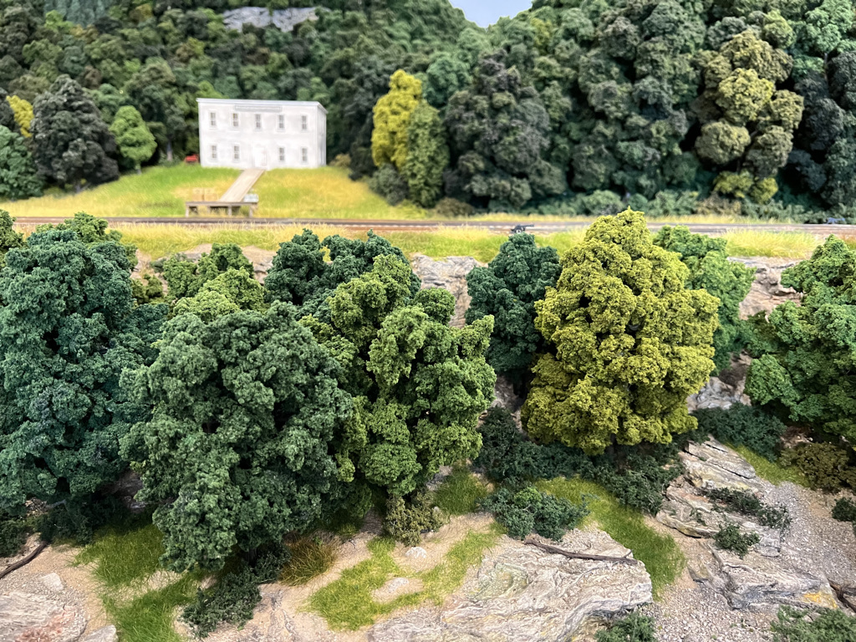
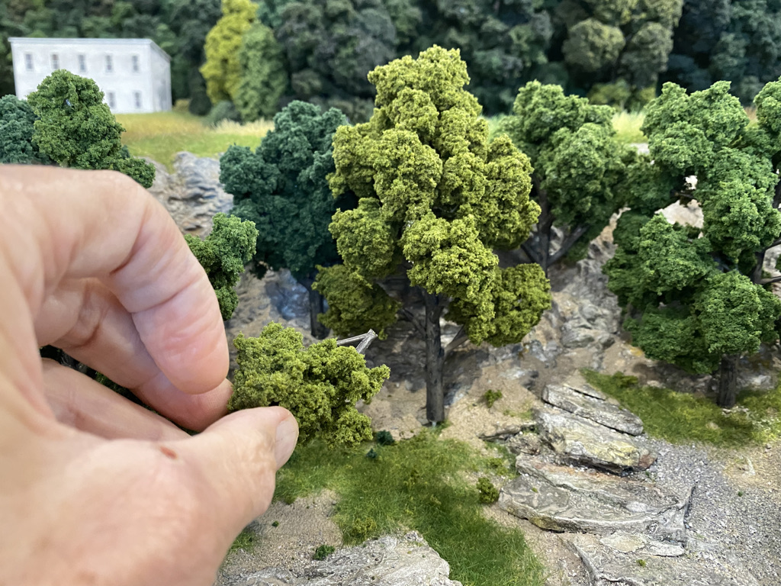
SCALEABLE TECHNIQUE MICRO:
FOREGROUND TREES DECIDUOUS I found that Woodland Scenics readymade ”Realistic Trees” can be upgraded by hot glueing on extra foliage, and painting the exposed lower trunk grey-brown and washing with diluted black ink. Then the foliage is sprayed with diluted black ink to knock back the brightness of the green, blend, and differentiate the trees.
Gaps can be filled in by cutting branches of matching colors and hot glueing on

Slide 20
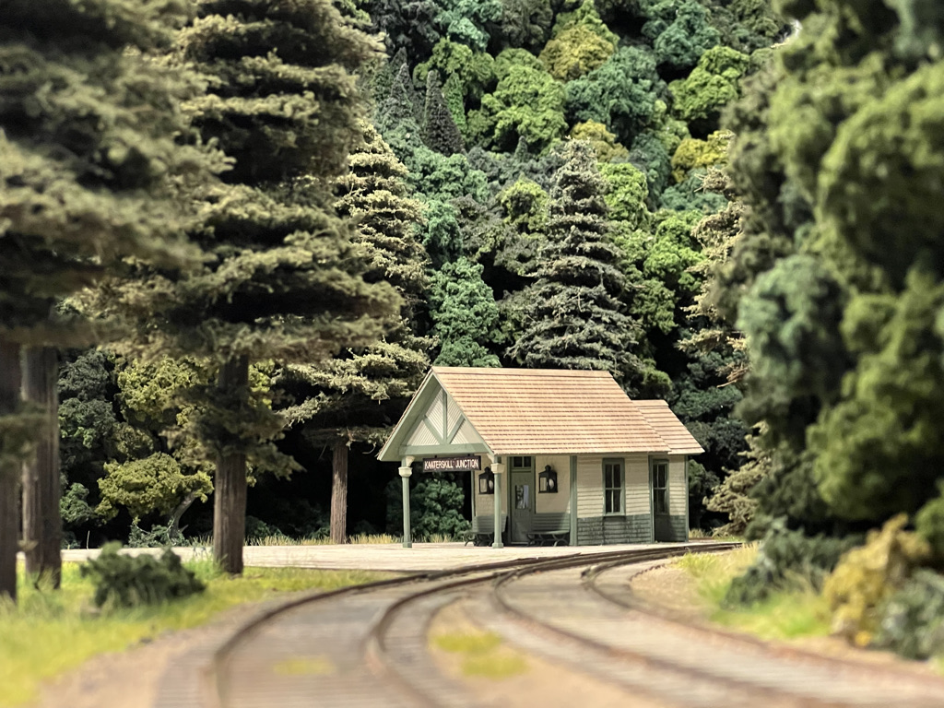
SCALEABLE TECHNIQUE MICRO:
FOREGROUND TREES – EVERGREEN
I needed the distinctive shape of conifers, in this case hemlocks, but no ready made trees looked realistic to me. I have been building trees by Coastmans. It is time consuming, but picking one item to make by hand is manageable.
Kaaterskill Junction

Slide 21
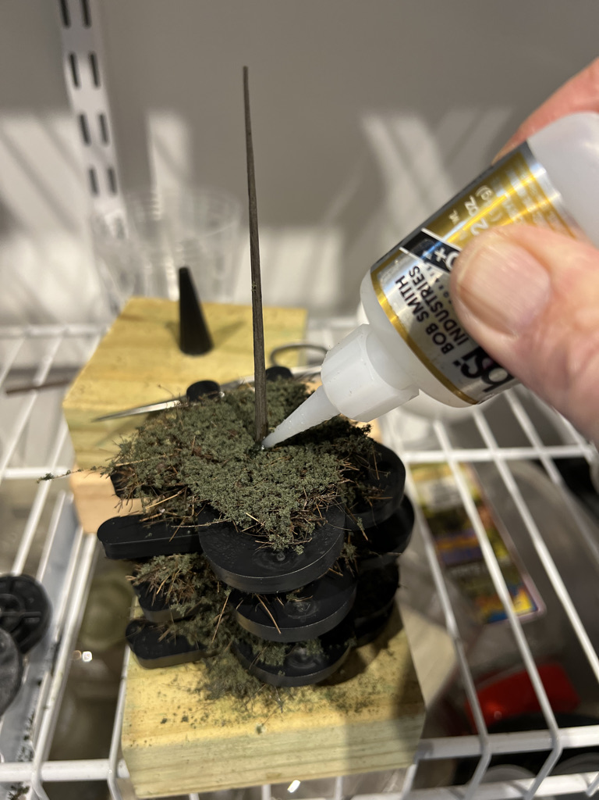
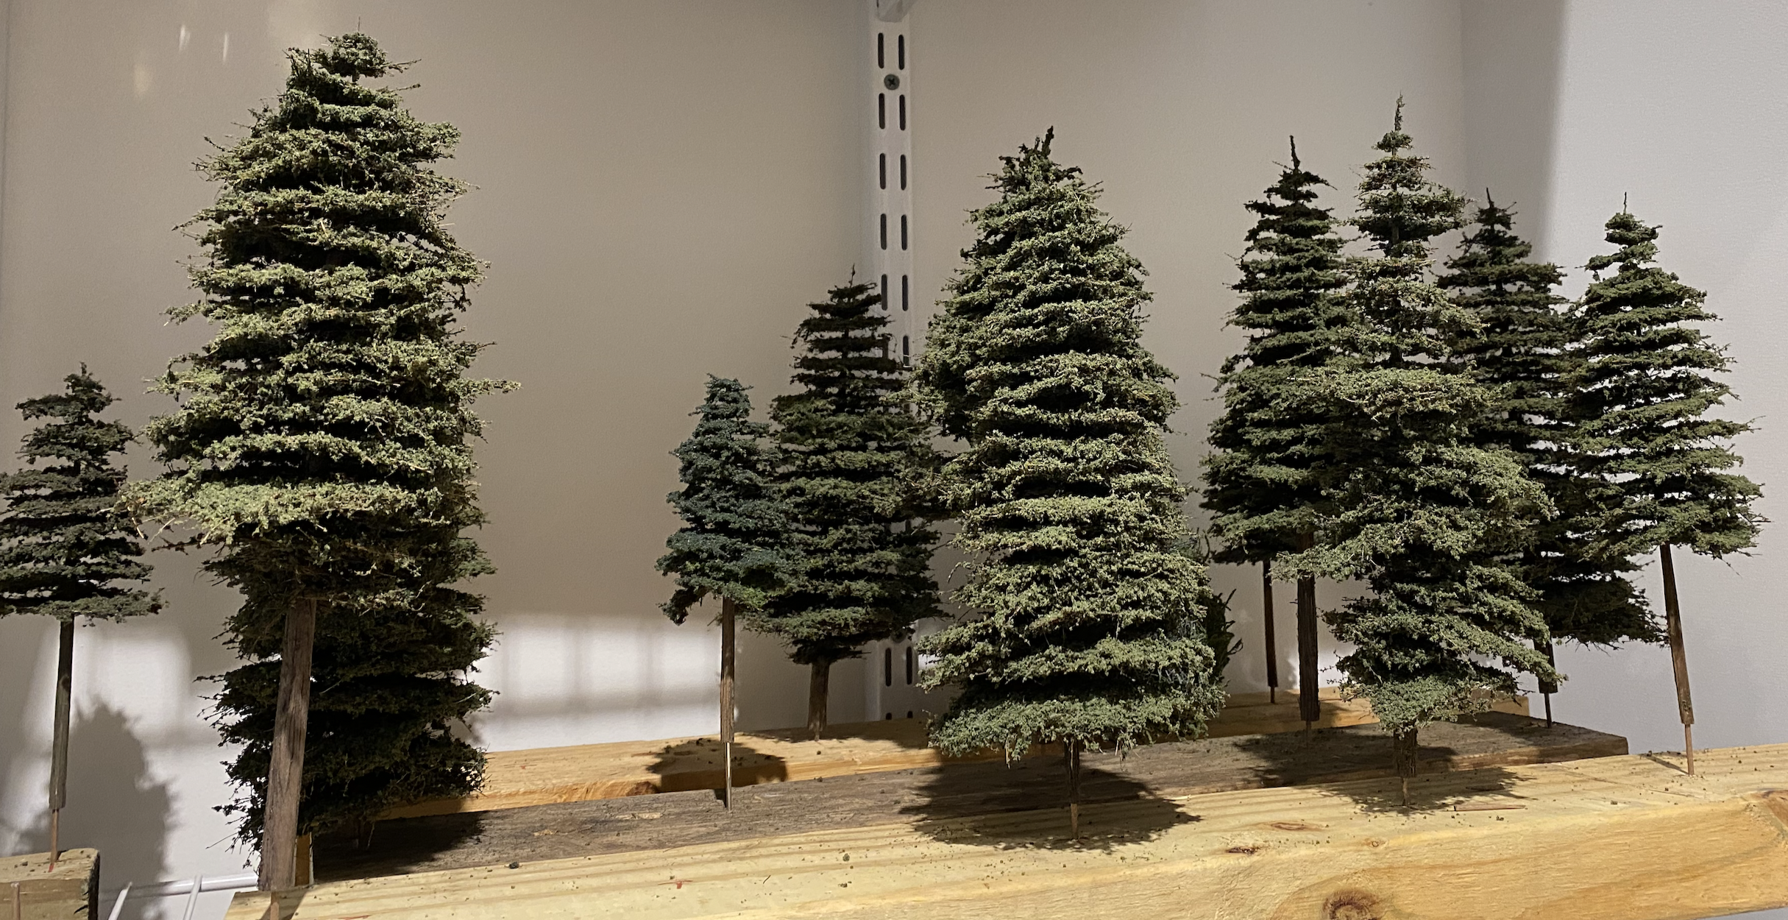
SCALEABLE TECHNIQUE MICRO:
FOREGROUND TREES – EVERGREEN
Coastmans’ trees have realistic textured trunks in a variety of sizes. Their coir sheets come covered with ground foam and are torn into circles, spaced with 1/4” horseshoe spacers and glued in place with ca or white glue.

Slide 22
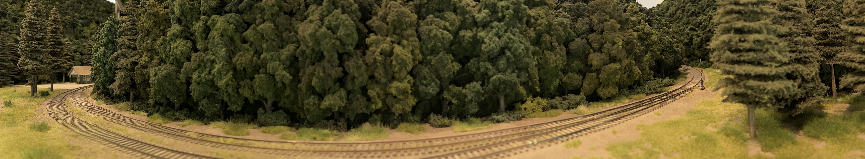
SCALEABLE TECHNIQUE MICRO:
EDGE OF WOODS – SHRUBBERY
I landscaped hundreds of feet at the edge of the woods using these techniques. Behind the trees at the edge of the forest I applied dark green clump foliage. On the visible edges, I used combinations of colors of Woodland Scenics fine leaf foliage branches and a little coarse foam for low growing plants.

Slide 23
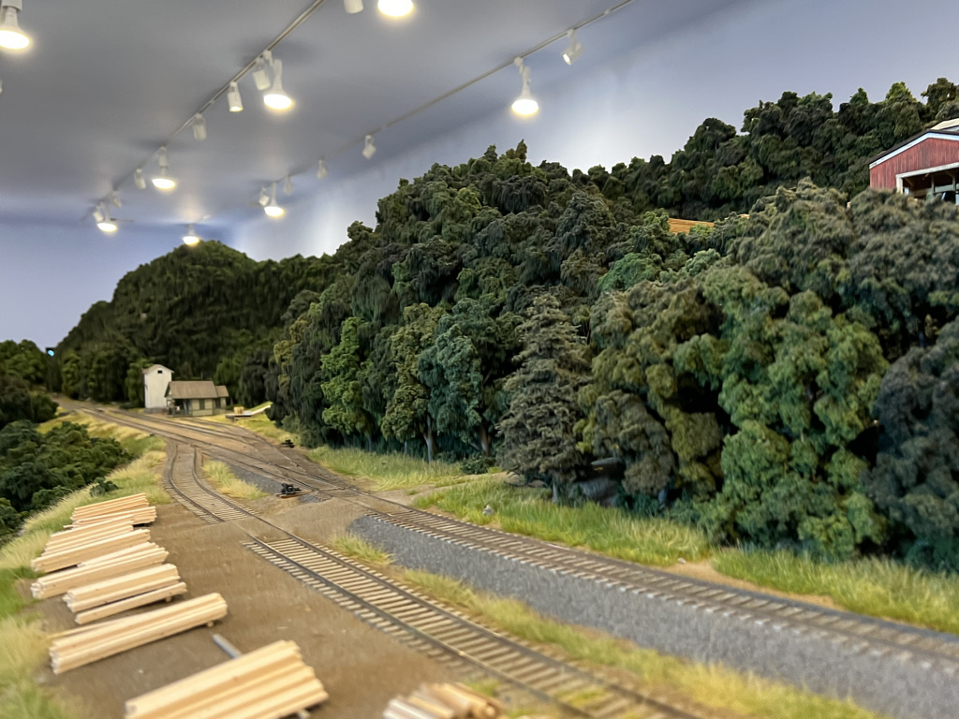
SCALEABLE TECHNIQUE MICRO:
EDGE OF WOODS – WEEDS
Static grass makes the best weeds, but it cannot be applied close to anything or on steep slopes. I make static grass sheets by spreading Alene’s Tacky Glue on a silicone rubber baking sheet and applying the grass. Once dry, it peels off and can be torn into shapes and glued down. Walthers SceneMaster Tear & Plant mat Spring Meadow works the same way.

Slide 24
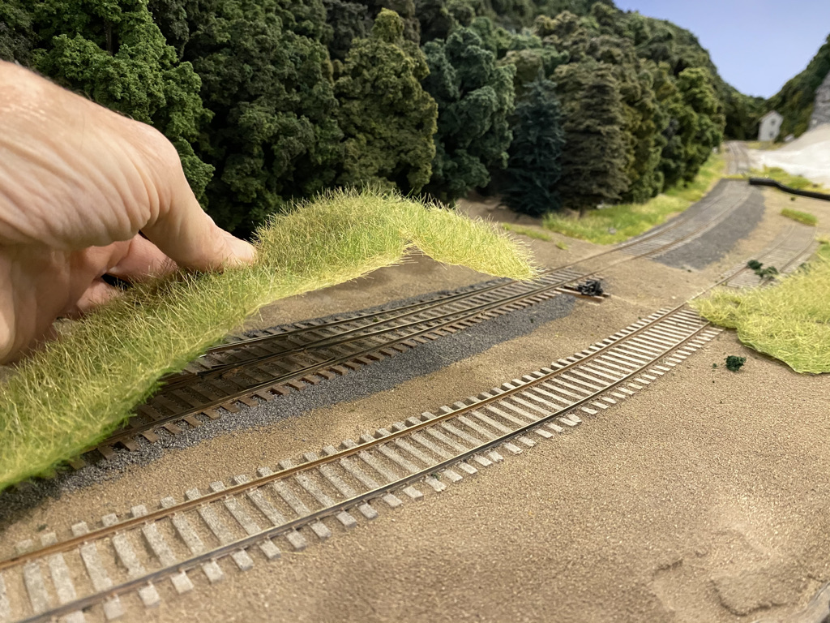
SCALEABLE TECHNIQUE MICRO:
EDGE OF WOOD –WEEDS
The homemade sheets are torn to irregular shapes and glued down to the dirt with Ailene’s Tacky Glue.

Slide 25
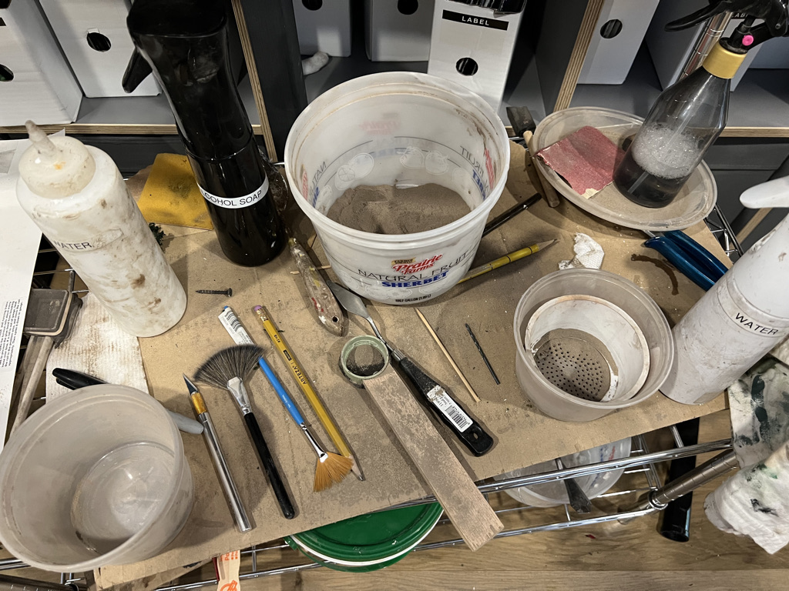
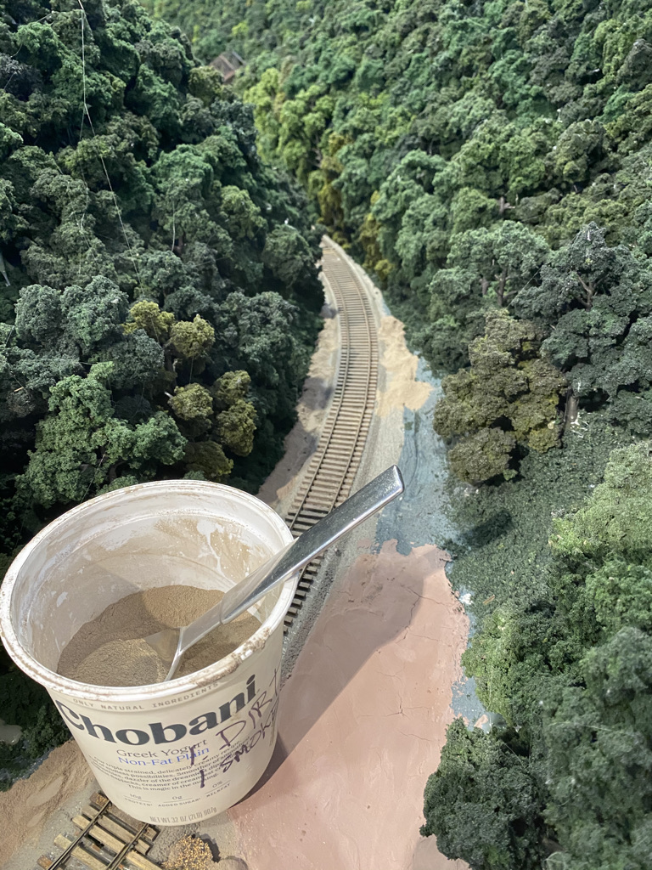
SCALEABLE TECHNIQUE MICRO:
DIRT
Research the dirt color you want, find a substantial source of an appropriate color and a matching non-sanded grout. Sift the dirt to very fine. Mix the grout and dirt 50-50. Spread the mixture on the layout and smooth with the fluffy fan shaped brush. I made applicators like the ones below consisting of a cup with a stocking on the bottom to sift the dirt evenly over the surface.

Slide 26
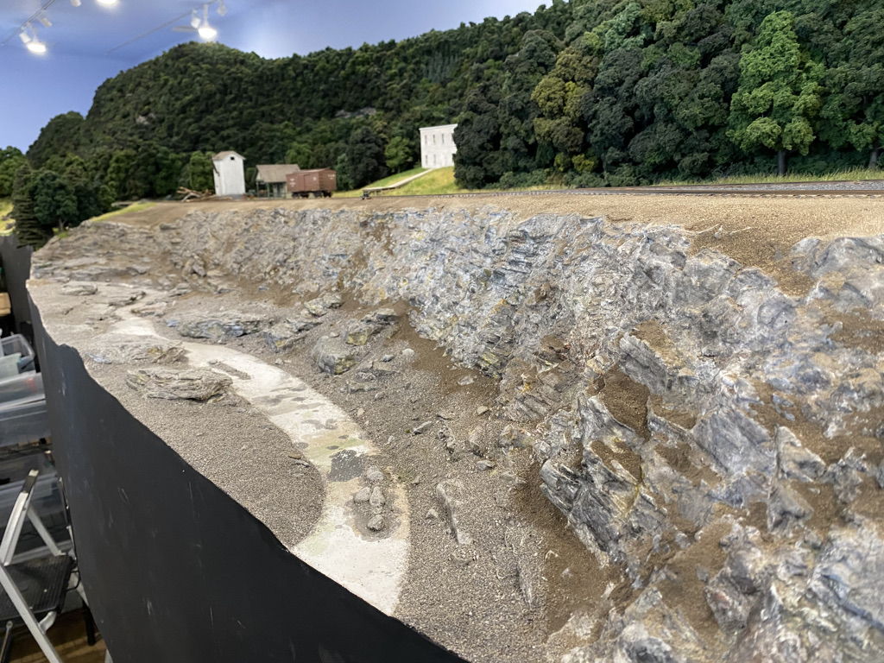
SCALEABLE TECHNIQUE MICRO:
Dirt
Brush the dirt over the surface with the fine fan shaped brush so it collects naturally in crevices in the rocks.

Slide 27
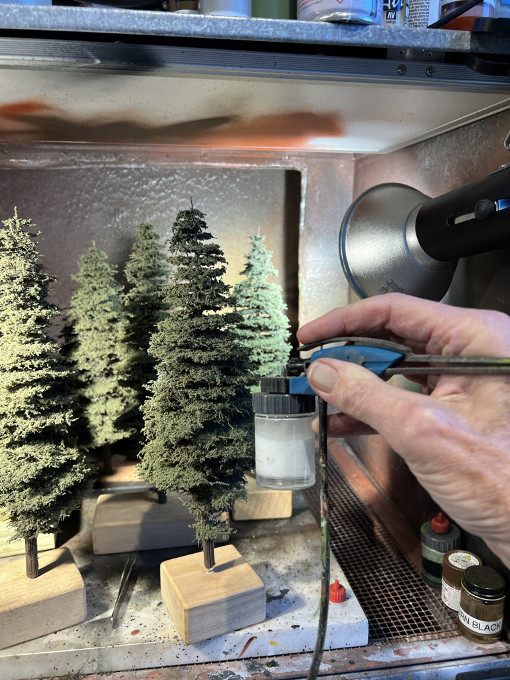
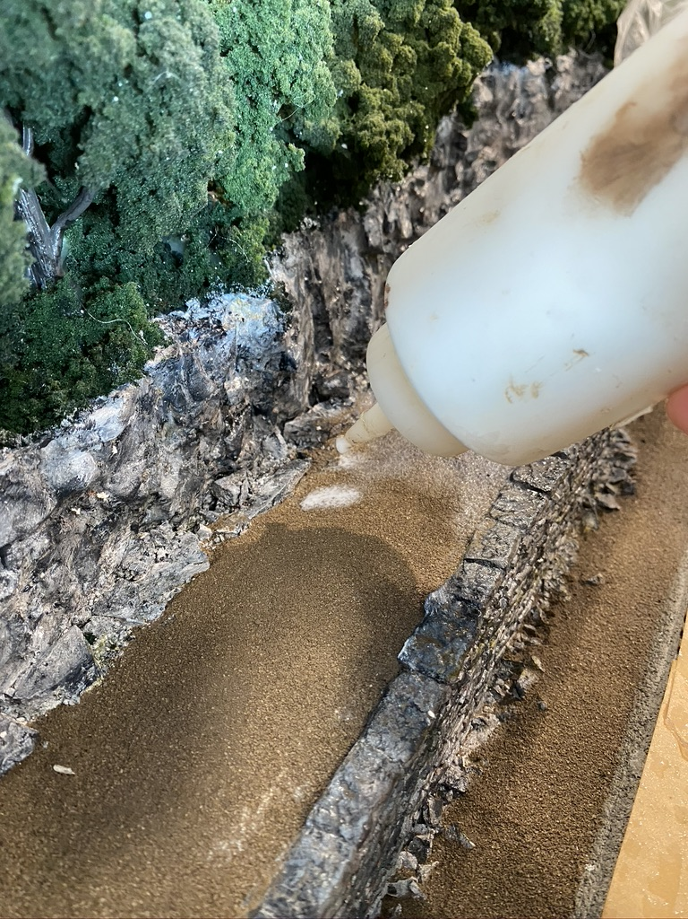
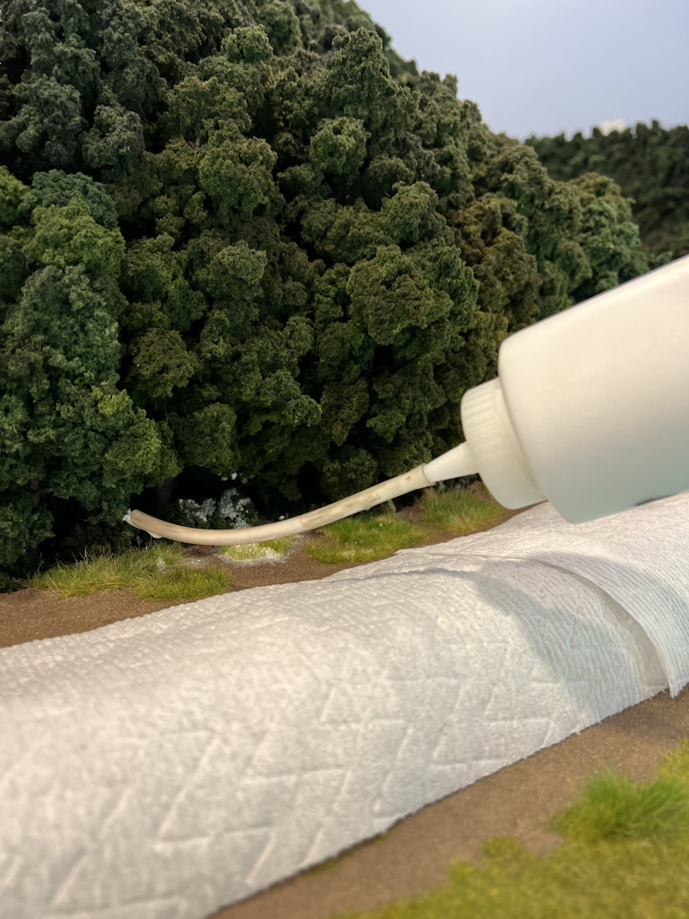
SCALEABLE TECHNIQUE MICRO:
Adhere Everything
For trees, edge of woods grass and shrubbery, dirt, and ballast everything should be glued in place. Dirt and ballast must be completely soaked with alcohol and wet water or the under layer will not adhere. Use a fine mist sprayer like the black and white ones in the picture on slide 24. Then mix 1/2 matte Modge Podge with 1/2 water and apply with a large bottle. Do not waste time with an eyedropper. Mist it with more water to even it out. Soaking with glue is the most important thing here; usually all the glue disappears when dry. If not, after it dries, you can dust a little dirt on top and mist it again. Layers are fine as long as it all adheres.
Applying 50 50 Modge Podge-do not use
Elmers, it has been reformulated and skins
over too fast.

Slide 28
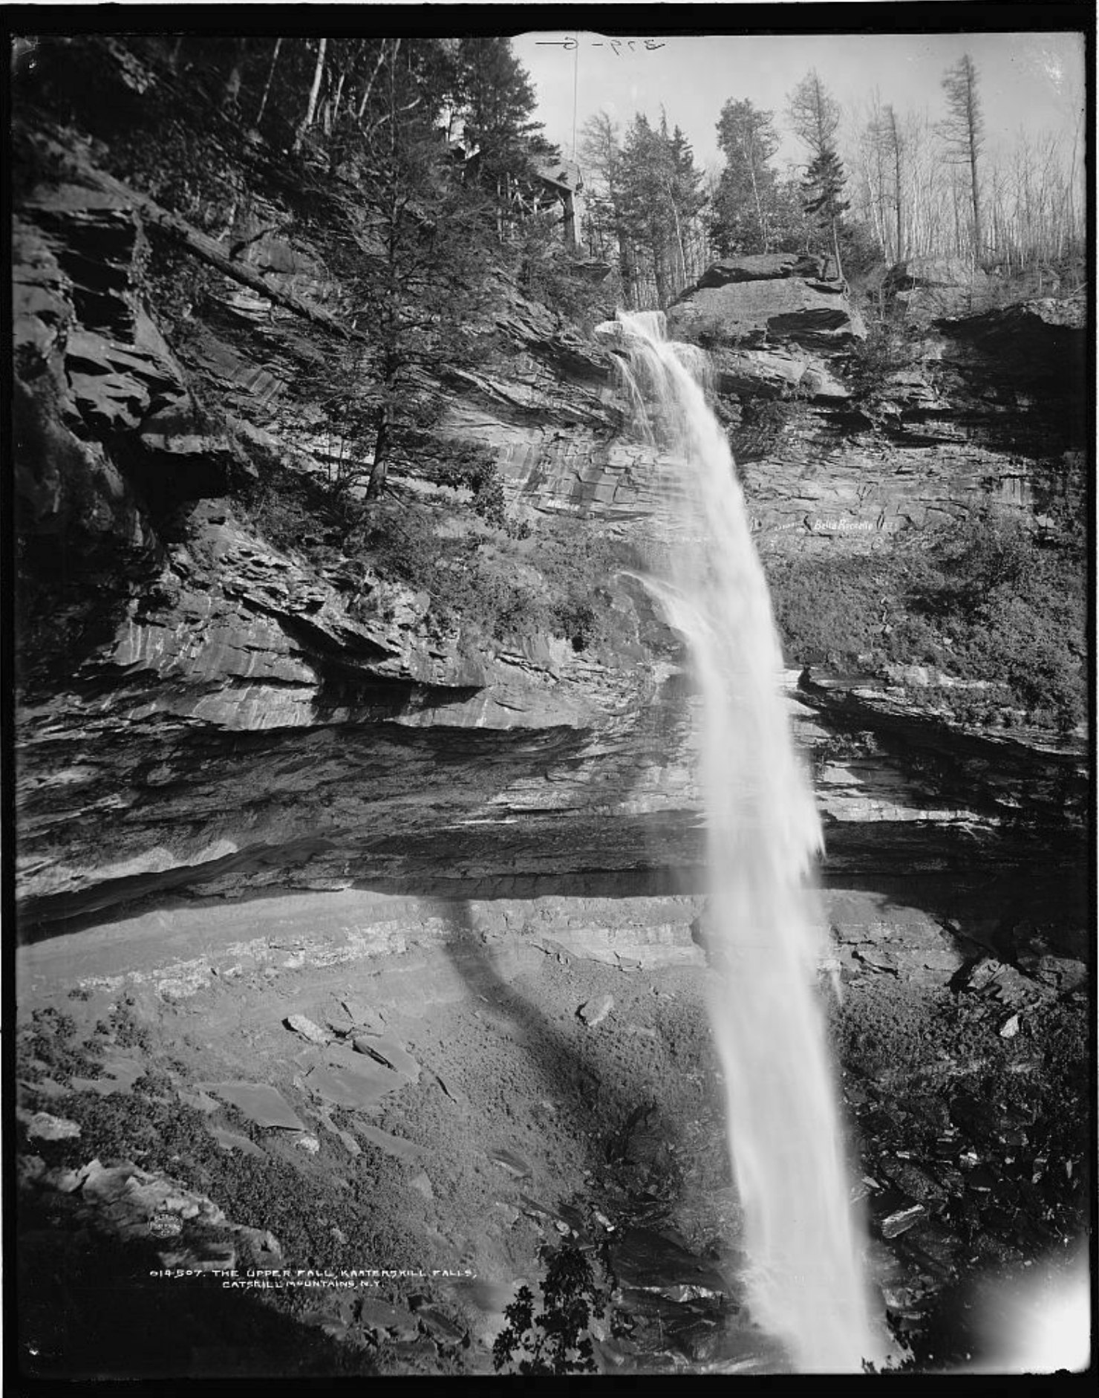
SCALEABLE TECHNIQUE MICRO:
ROCK CLIFFS
Kaaterskill Falls is a famous feature of the dramatic Catskill Mountain landscape of the U and D. But faced with 16 square feet of rock, again, scaleability was necessary. I found several sources of flexible rock sheets that could be cut, curved, and glued together, and Larry Janeski formed the massive rock face that had been eroded by the falls. These areas were created with Flexrock, 17” x 7.5“ from Scenic Express and rubber rocks from Cripplebush Models 25” x 9”.

Slide 29
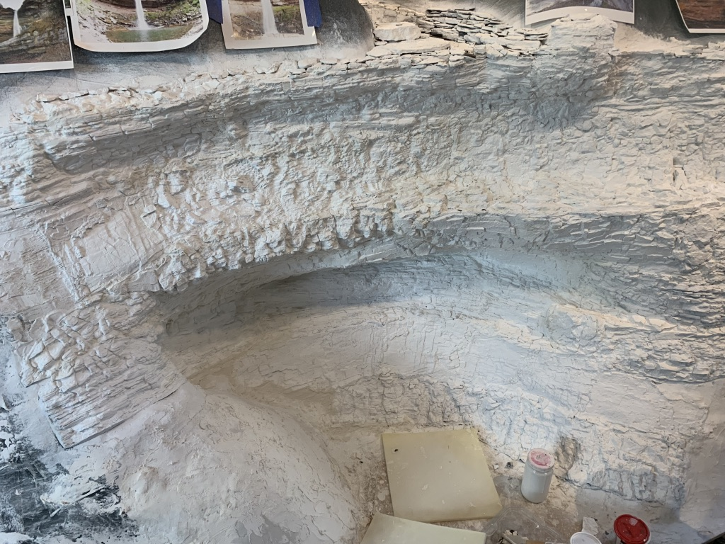
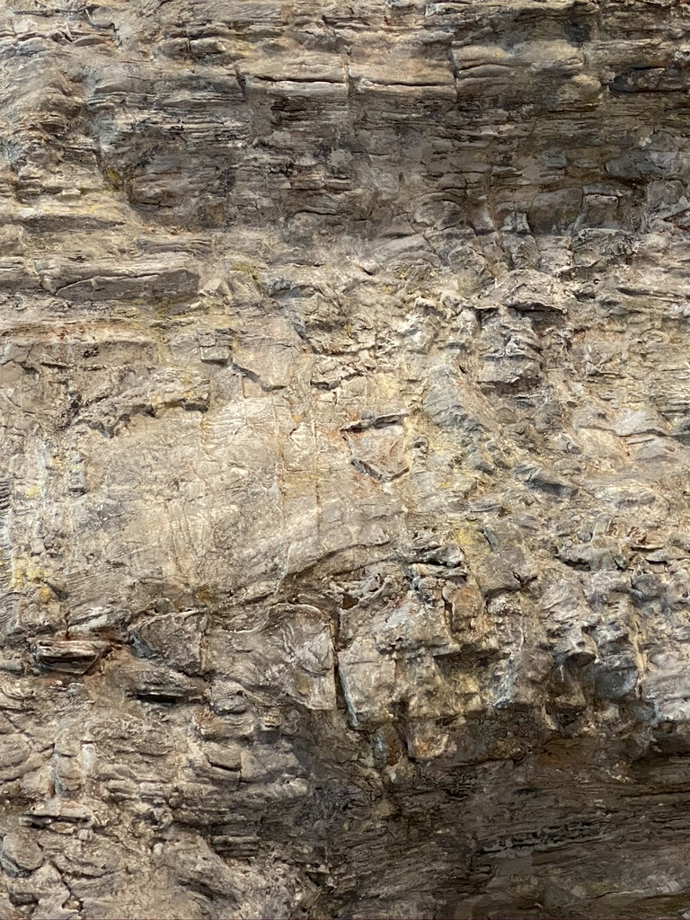
SCALEABLE TECHNIQUE MICRO:
ROCK CLIFFS
Rocks are painted white and washed with multiple diluted colors of acrylic.

Slide 30
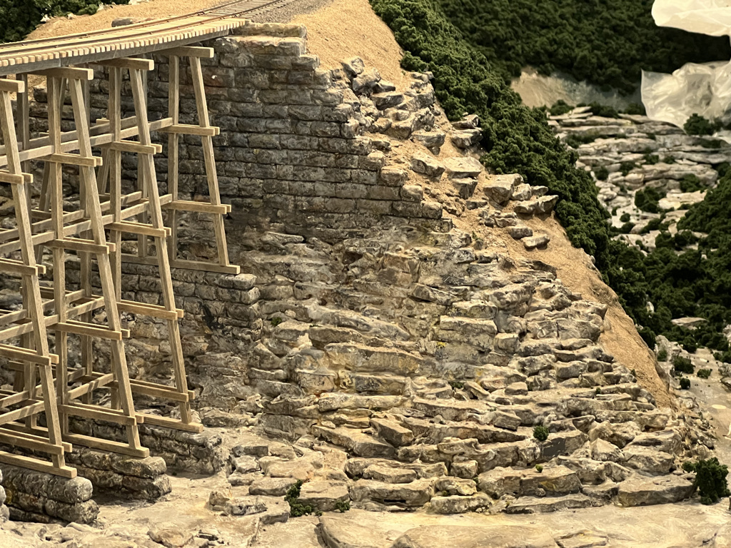
SCALEABLE TECHNIQUE MICRO:
STREAM BEDS, ABUT-
MENTS, AND OUTCROPS
For 50’ of watercourses I found real rocks that broke into flat planes and water rounded rocks. And I made rocks by crumpling sheets of aluminum foil, flattening them out, and layering them with plaster of paris. The layers were then broken up into pieces. All were painted white and weathered with diluted acrylic colors. The railroad used massive stone blocks for abutments. I made them by casting plaster into a latex mold pulled from a large sheet of O scale stone wall.
Haynes Falls trestle

Slide 31
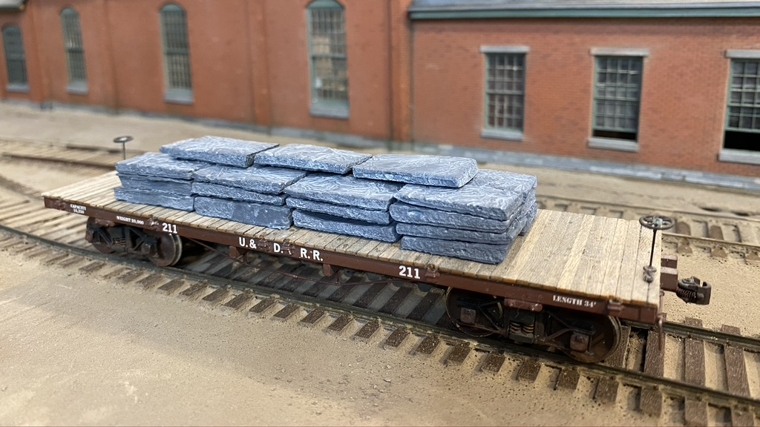
Extensive bluestone quarrying on the Ulster and Delaware added to the need for rocks. For bluestone slabs I used the plaster poured on crumpled aluminum foil technique described on page 29 and scribed and broke the sheets into rectangular pieces.

Slide 32
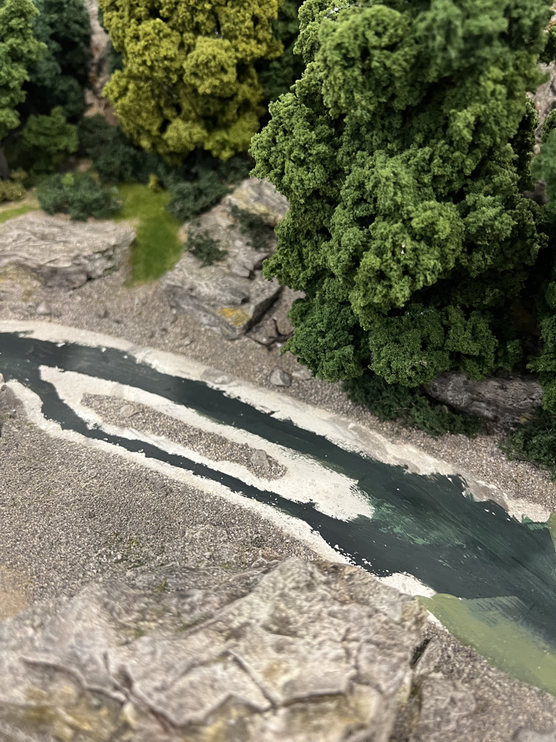
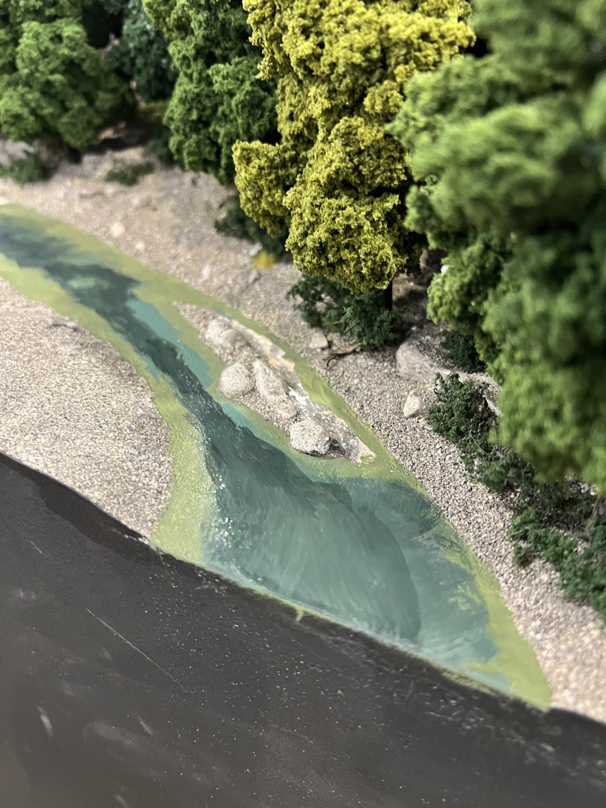
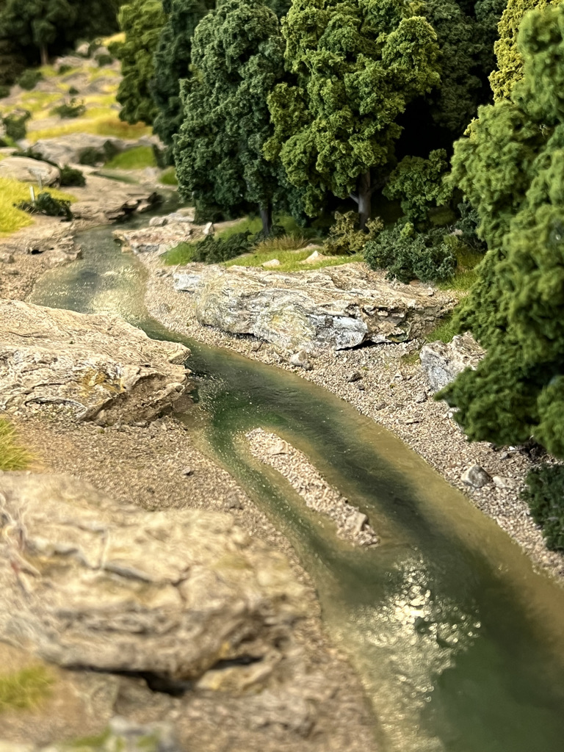

SCALEABLE TECHNIQUE MICRO:
WATER With over 50’ of water to do, poured resin was not practical. The smell, the damming problems, the way it creeps up everything it touches, and the fact that you can’t see below the surface of most water courses ruled it out. I paint the bottom with oil paints so the colors blend easily. I let it dry and then I put on several coats of gloss Modge Podge. Ripples are added with gloss gell medium, and finally gloss gell mixed with white paint makes foam.

Slide 33

SCALEABLE TECHNIQUE MICRO:
Ballast
With hundreds of feet of track to ballast and no tolerance for ballast stuck to the side of the rails, I needed a system. To avoid having the ballast diameter match the tie width, which I see so often, I use fine ballast. It is dyed with diluted ink to knock back the brightness. I radius the shoulders of the cork roadbed to have a better profile. Then I spoon on ballast and brush it into approximate position with the soft fan shaped brush. I use foam blocks or foam paint brushes applied flat to the ties that catch the ballast, moving it off the ties and rails, and depositing it in the gaps between the ties. Foam is the only material I found that works.
As you can see in the picture at the left, much of the railroad had no stone ballast, and dirt is applied in the same way.

Slide 34

SCALEABLE TECHNIQUE MICRO:
GRASS AND WEEDS
Static grass is the answer for large acreage, but most equipment and instruction will not work at scale. Battery powered systems are too weak, switching colors when using only one applicator takes so much time that you can only do a few inches before the glue dries. Woodland Scenics Static King is the most reliable, strong and effective. The other five I tried have been discarded. Get a few of them because glue dries fast and you don’t have time to change fiber types.

Slide 35



SCALEABLE TECHNIQUE MICRO:
Static Grass Application Before starting, put up paper towels to keep the fibers off the other scenery. Apply matte Modge Podge diluted with water or a grass glue. Do not use Elmers, as the new formula skins fast and will not work. First, I do patches of glue and apply tall grass. Vacuum the work, then I put on more glue for newer shorter grass, leaving some dirt showing. To get the variety of colors seen in the first slide you have to apply the grass through a piece of cardboard with a hole in it to narrow the area of application.
I find that the most useful fiber to pull everything together is the blend that has 4mm olive and beige grass called meadow. After drying, you can go back and put glue on the existing grass and apply more grass to create interesting clumps of weeds, flowers on fiber stems, and shrubs or just taller grass.

Slide 36

The taller grass is 12mm, while the shorter is 2 to 5mm.

Slide 37

Flowers, seed pods, and or leaves may be applied to glue brushed onto the fibers.

Slide 38

The home-made grass mat is glued down on the other side of the track while the grass in the front is applied to the dirt.

Slide 39

Eagle Springs Water in Edgewood

Slide 40


Slide 41

SCALEABLE TECHNIQUE MICRO:
Surface Textures
The last step before finally fixing the area with diluted Modge Podge is to apply surface materials appropriate for the scene. In this one, I have leaves chopped up in a blender and tiny twigs on the ground under the trees.

Slide 42

SCALEABLE TECHNIQUE MICRO:
Surface Textures
From old postcards of the area I saw rocks on all the roads. I put stones of the correct size on the ground and road using large and medium ballast. Remember to soak with 50 50 Modge Podge to stabilize.

Slide 43

SCALEABLE TECHNIQUE MICRO:
Surface Textures
More rocks can be seen in this closeup. And some static fibers with fine turf leaves were created. It is amazing that this level of magnification of such tiny objects is so convincing. Though that bit of ground foam has to be removed

Slide 44
CONCLUSION
Building a large layout is a formidable undertaking. My experience from two failures and the current success is:
1. There’s nothing worse than discovering you don’t like the layout you are building. Get the planning and design right before starting. It’s much easier to tear up and revise the model layout than the full size layout.
2. Find construction techniques that erect quickly with functioning trackwork so you don’t get discouraged by getting bogged down in beginning and intermediate stages, before the rewards of some finished areas can raise your spirits.
3. Use systems that scale to your larger layout size. Use flextrack, purchase switches, buy Modge Podge by the gallon, avoid foam landscape, avoid spline subroadbed, avoid handlaid track, avoid resin water, avoid the bumps and dimensional unreliability of homasote, avoid tiny plaster rock molds and all labor intensive beginning and intermediate techniques.
4. Save your energy for the necessarily labor intensive and rewarding finish work.
5. Get your trackwork finished early so you can run trains and have some fun even if the landscape is incomplete.
6. Pick a scene or two and move it ahead toward finish. It will show if you are preparing for the result you want, indicate changes you need, and provide an inspiration to get the whole layout developed to that level.
The satisfaction of creating your own beautiful world is especially rewarding these days.
Willy Monaghan rondoutroundhouse@gmail.com

